Slide 1

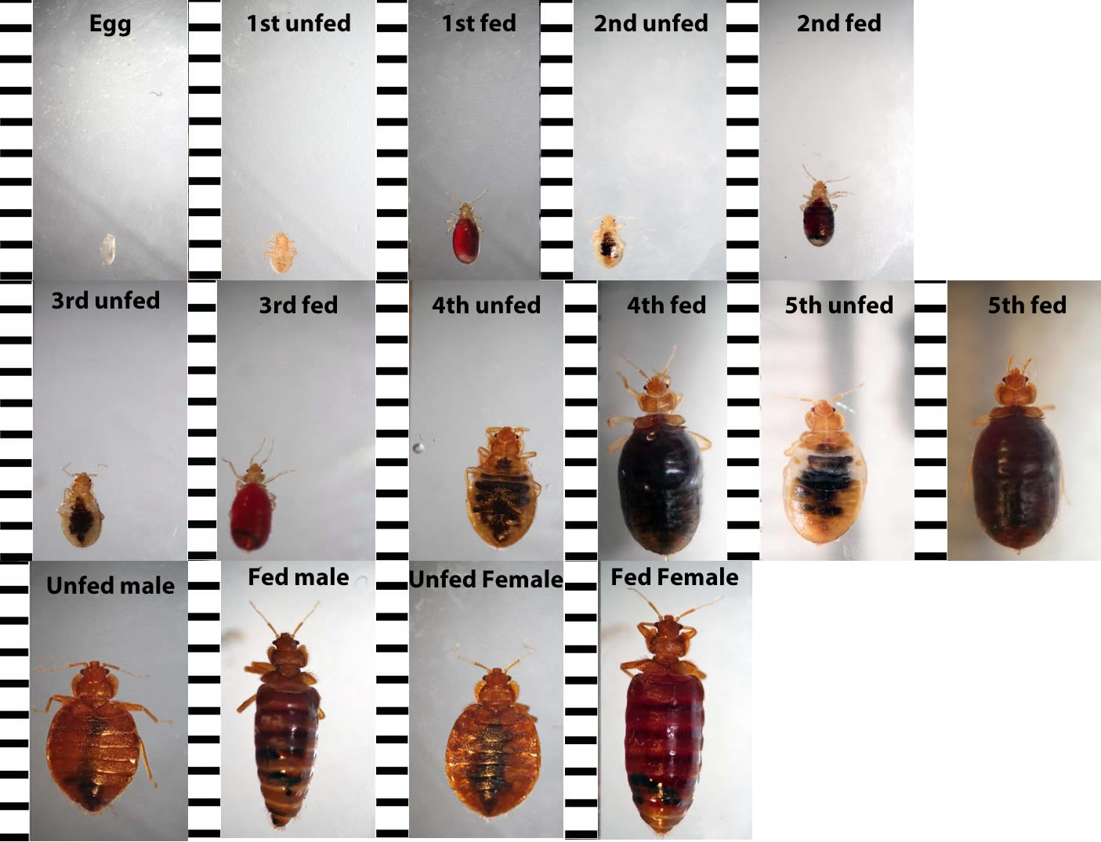
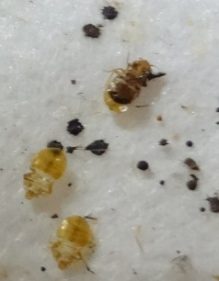
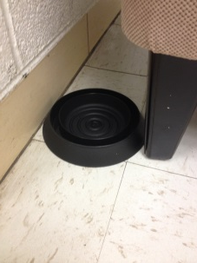
E&PP Info # 829
7 March 2014
Resident’s Role in Managing Bed Bugs & German Cockroaches
Karen Vail, bedbugs.utk.edu & Allie Taisey, stoppests.org
=1/16 inch
=1/3 inch
Black fecal spotting and shed skins on mattress encasement.
Fed and unfed bed bugs. The five (5) baby stages look like small adults.
Place one (1) BlackOut bed bug monitor against one of the legs at the head of your bed. Ideally, between the leg and the wall.
Place one (1) BlackOut under the chair/sofa you use most. Place the BlackOut against the chair leg nearest the wall.
Check monitors weekly.
If you find a bed bug, call the housing office desk at XXX-XXXX. Management will confirm it's a bed bug and work with you and a pest professional to get rid of them.
If pests are found early, then control will be faster and there will be less work for you to do!
What you can do to help manage bed bugs:
Straighten up your home and vacuum. Being neat does not decrease your chances of getting bed bugs, but it makes them easier to find and will make the control efforts work better.
Wash your sheets weekly and other bedding at least once a month. Dryer heat kills bed bugs.
Do NOT use bug bombs or over-the-counter sprays. Foggers can be unsafe and won't get rid of the bugs.
When you pay rent, you pay for pest management! You will not be blamed, charged, or evicted due to a pest infestation. Housing wants you to call XXX-XXXX to report pests (including bed bugs)!

Slide 2
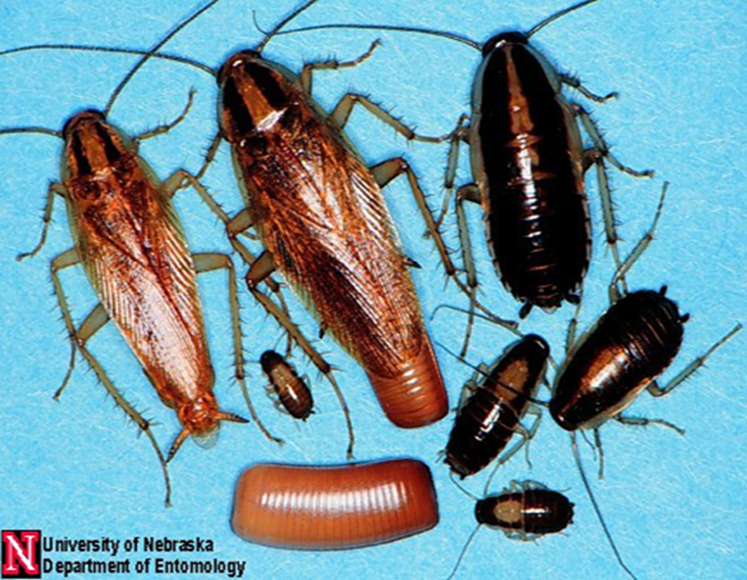
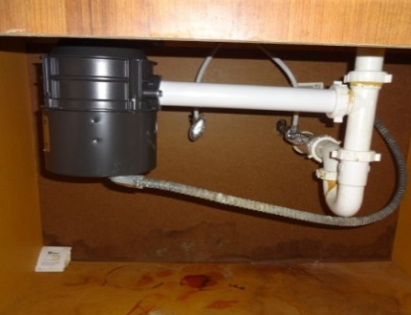
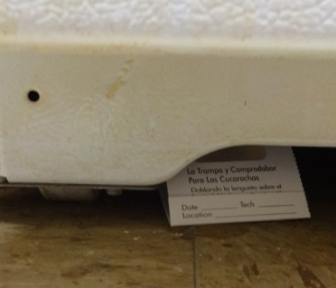
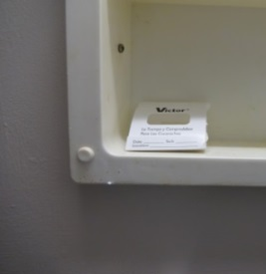
German cockroaches: ½ inch adult male (left) and female (with egg case), darker babies or nymphs (white spot on back) and an egg case.
German cockroaches cause and trigger asthma. Help us keep the building pest-free by doing your part in pest control:
Set three (3) traps: 1. Remove paper covering the sticky surfaces.
2. Fold the traps into triangles.
Place one (1) in the cabinet, under the kitchen sink: along the wall,
near a corner.
Place one (1) under OR behind the refrigerator where you can reach it.
Place one (1) in the bathroom where it won’t get wet: in the medicine
cabinet, OR behind the toilet, OR above the medicine cabinet light.
Check traps weekly. If you see a roach in the traps or in your apartment,
call the housing office.
When you pay rent, you pay for pest management! You will not be blamed, charged, or evicted due to a pest infestation. Housing wants you to call 403-XXXX to report pests!
Being clean does help with cockroach control. Take away the roaches' food and water:
Wash and dry dishes every day,
Tie plastic garbage bags between uses,
Clean up spills and crumbs, and
Use plastic totes or sealable bags for storage instead of cardboard boxes—cockroaches love cardboard.
Do NOT use bug bombs or over-the-counter sprays. "Foggers" can be unsafe and do NOT work well.

