Slide 1
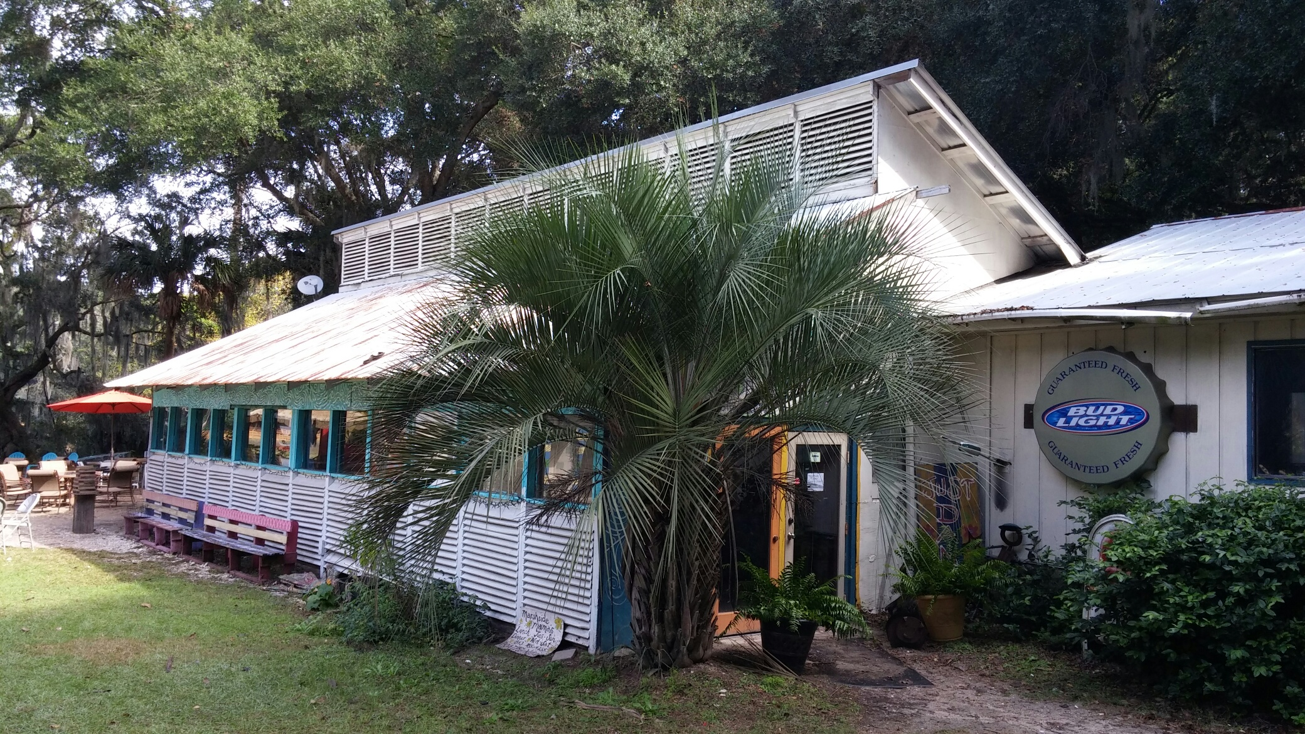
Restaurant and Pavilion Area
Water Damage and Rot
Missing/Broken Louvers and Leaking Windows
Main Entry and Front

Slide 2
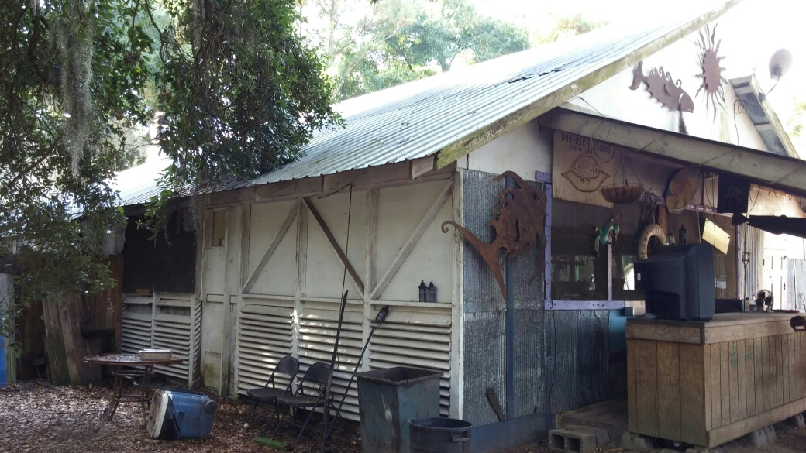
Water Damage and Rot
Exterior Bar On Blocks
Left Rear/Exterior Bar Area

Slide 3
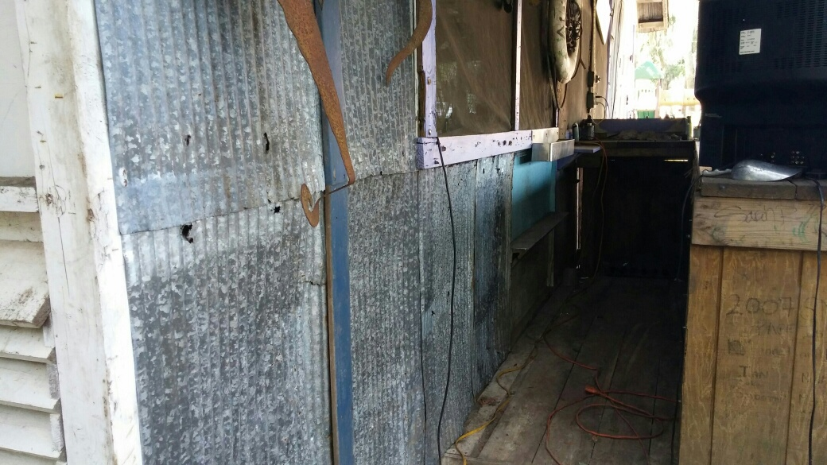
Holes
Exterior Bar Extension Cords
Right Side/Exterior Bar Area

Slide 4
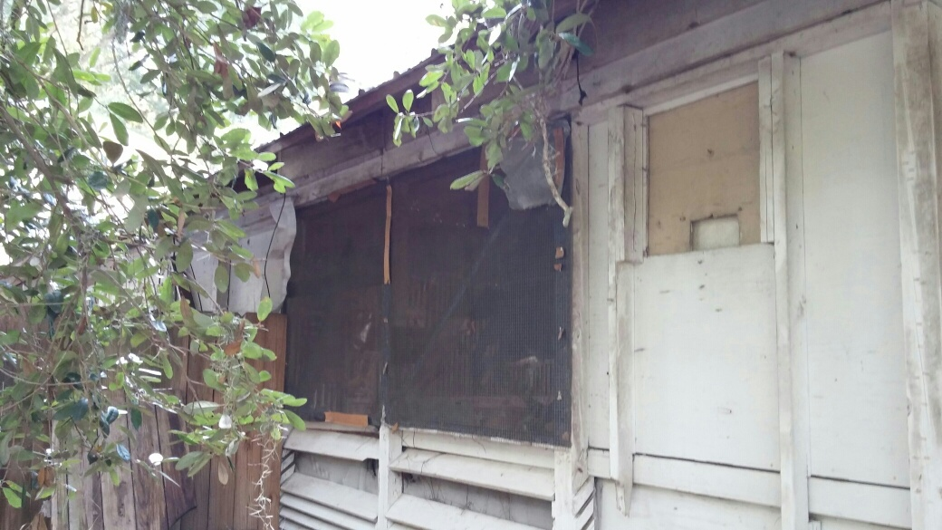
Patched Holes and Broken Framing
Missing Louvers and Holes
Rear Right

Slide 5
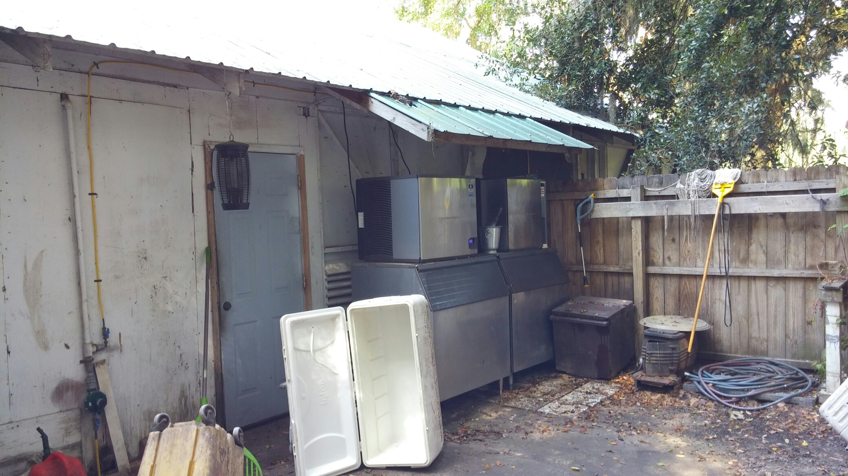
Water Damage, Holes and Rot
Rear Fenced Area

Slide 6
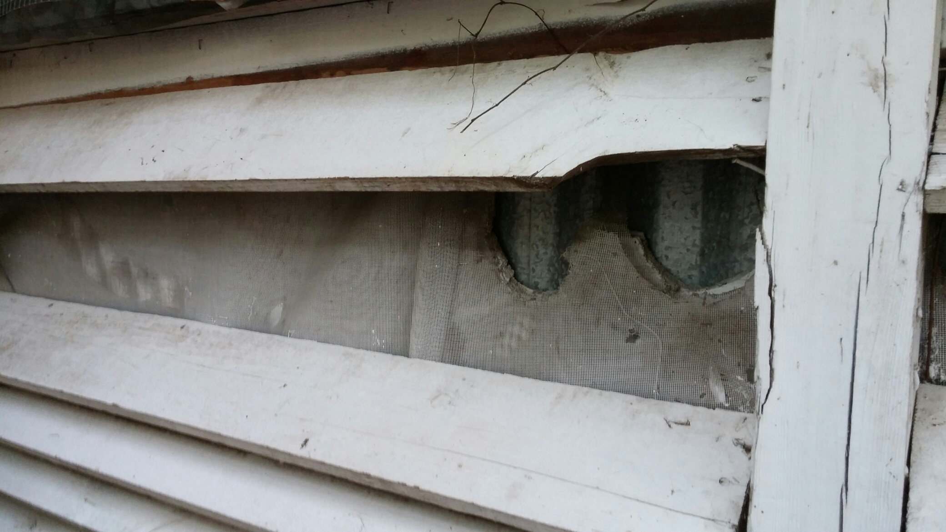
Missing Louvers and Holes
Rear

Slide 7
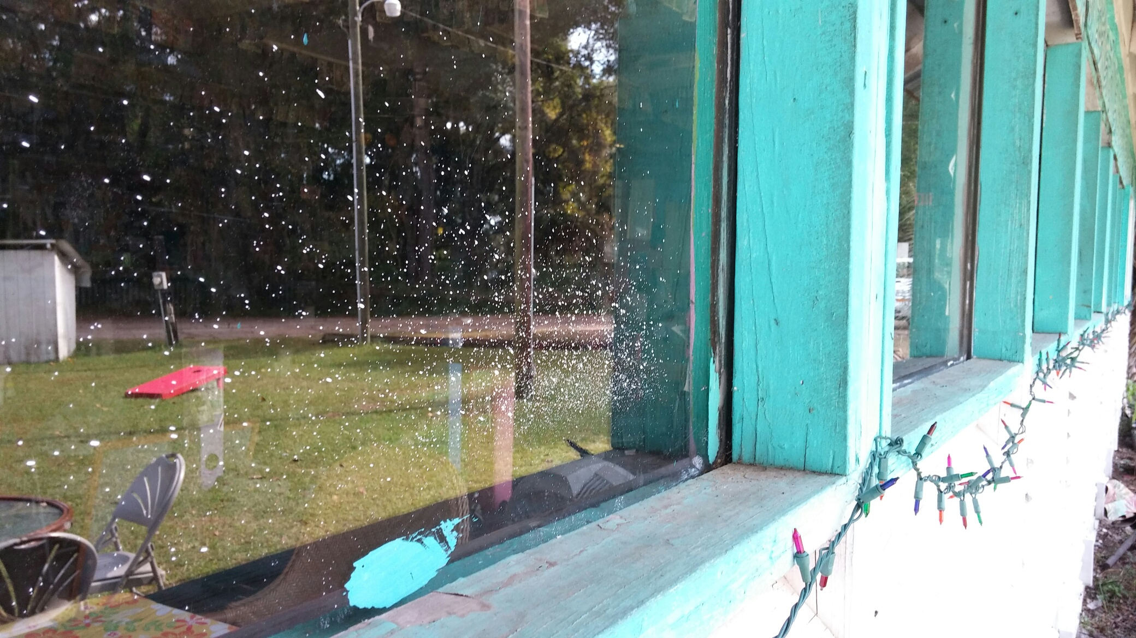
Window Close Up

Slide 8
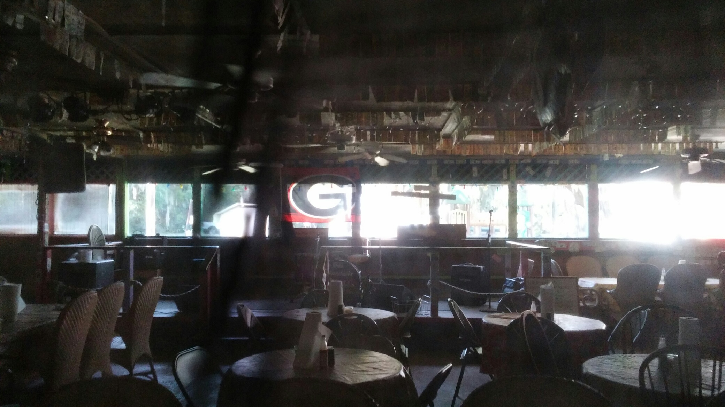
Interior Pic 1

Slide 9
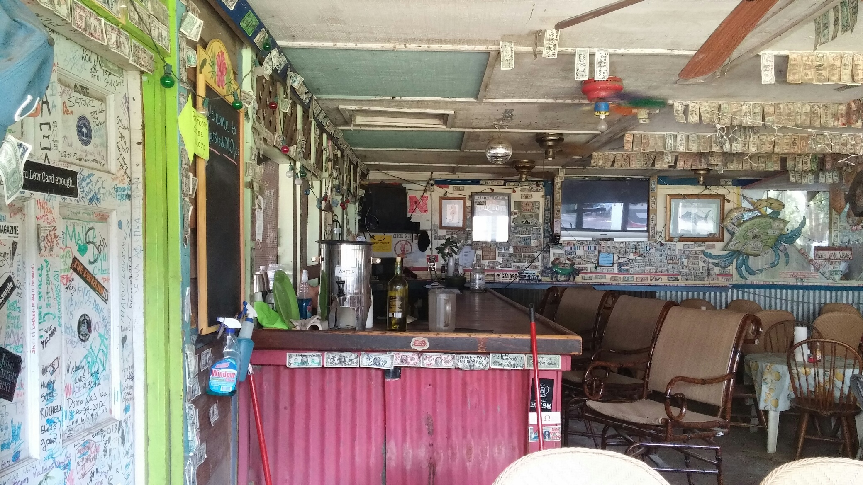
Interior Pic 2

Slide 10
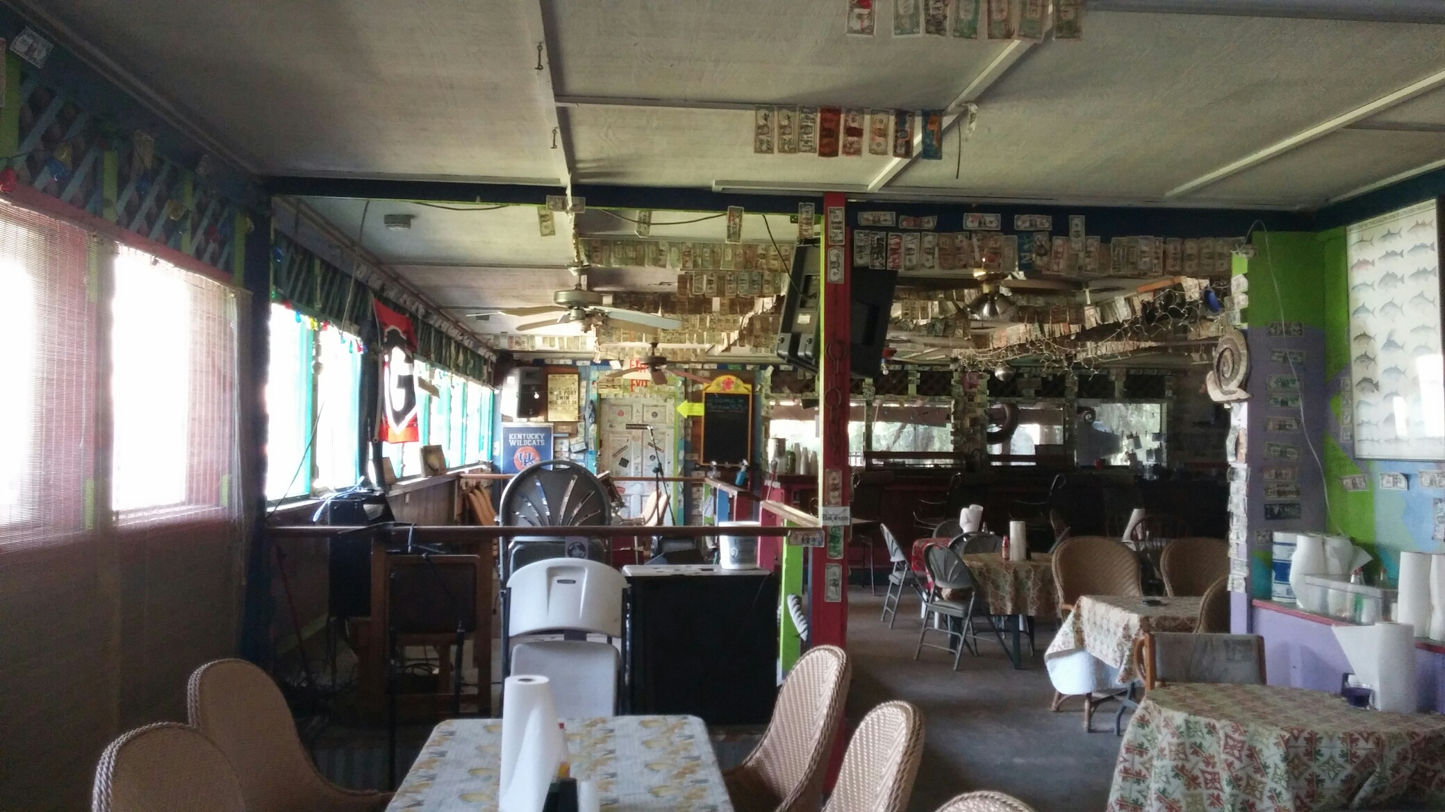
Interior Pic 3

Slide 11
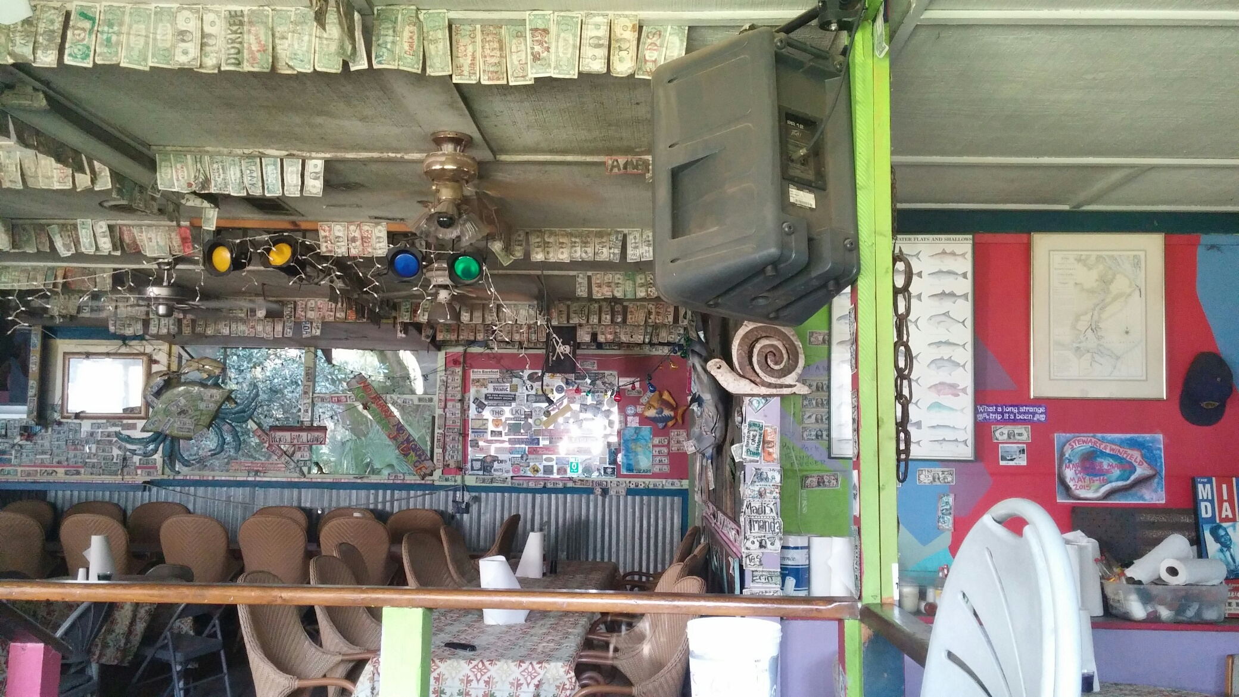
Interior Pic 4

