Slide 1
Village owned equipment
Concession Inventory

Slide 2
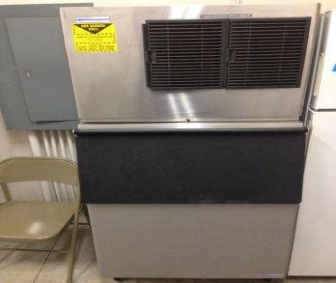
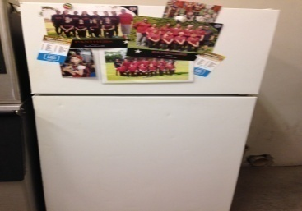
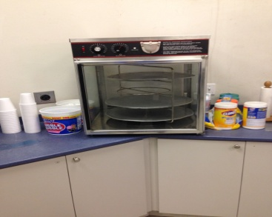
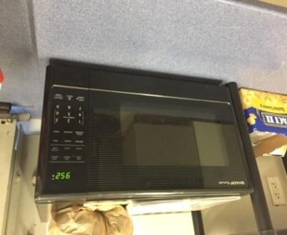
Quantity | Description (Manufacturer) | Model # | Serial # | Comments
(1) | MIMCO |  |  | Couldn’t move ice machine to get Model# and Serial#
(1) | GE | GTR18ABRERWW | HG797686
(1) | APW Wyott | HDC-4 | 390020712002
(1) | Sharp Carousel Microwave

Slide 3
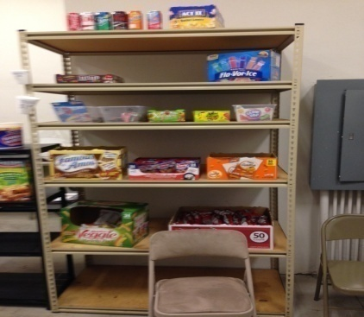
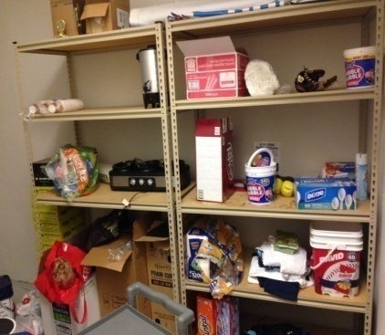
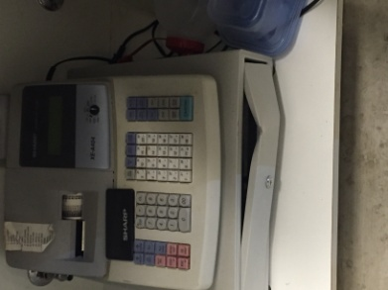
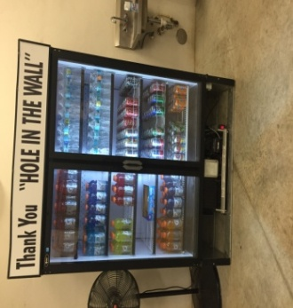
Quantity | Description (Manufacturer) | Model # | Serial # | Comments
(1) | SHELVING UNIT |  |  | Concession Stand Front Room
(2) | SHELVING UNIT |  |  | Concession Stand Back Room
(1) | Cash Register | Uniwell | C70738033 | Drawer damaged but works
(1) | Drink Refrigerator – “Thank You “Hole in the Wall”” |  |  | Donated by Hole in the Wall prior to SlamFest ‘16

Slide 4
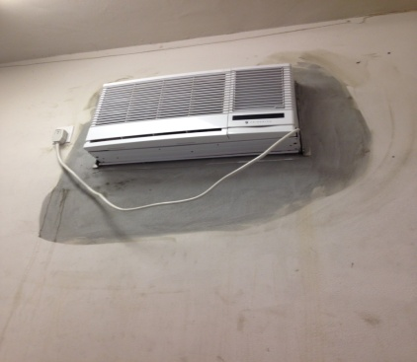
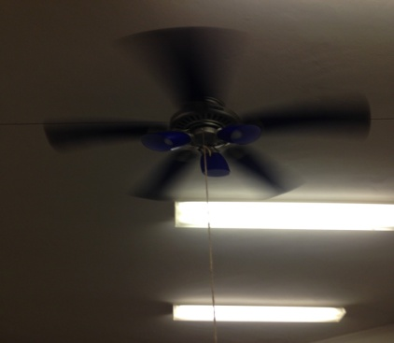
Quantity | Description (Manufacturer) | Model # | Serial # | Comments
(1) | Friedrich A/C Wall Unit
(1) | Ceiling Fan
(1) (1) (2) | Fire Extinguisher 2nd Floor of Quad ADT Security System |  |  | Additional items in the concession/quad

Slide 5
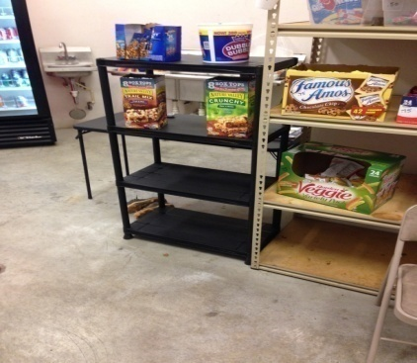
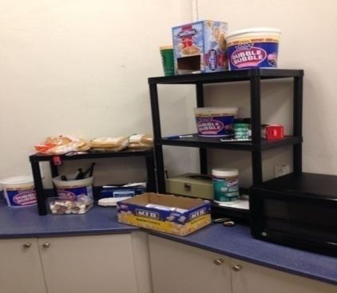
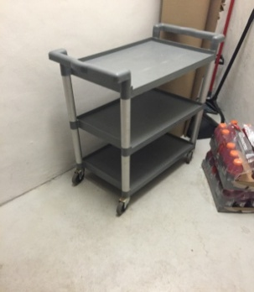
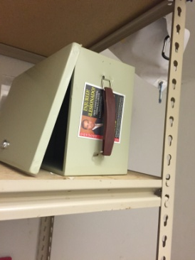
Quantity | Description (Manufacturer) | Model # | Serial # | Comments
(1) | Black Shelving Unit
(2) | Black Shelving Unit
(1) | Gray Rolling Cart
(1) | Cash Box

