Slide 1
Lake Apopka
Marsh Flow-way
C1 and C2 cell rehabilitation
Pre-bid meeting
August 19, 2020
Previous Maintenance
Work Summary
Bob Naleway
Marc Van Heden

Slide 2
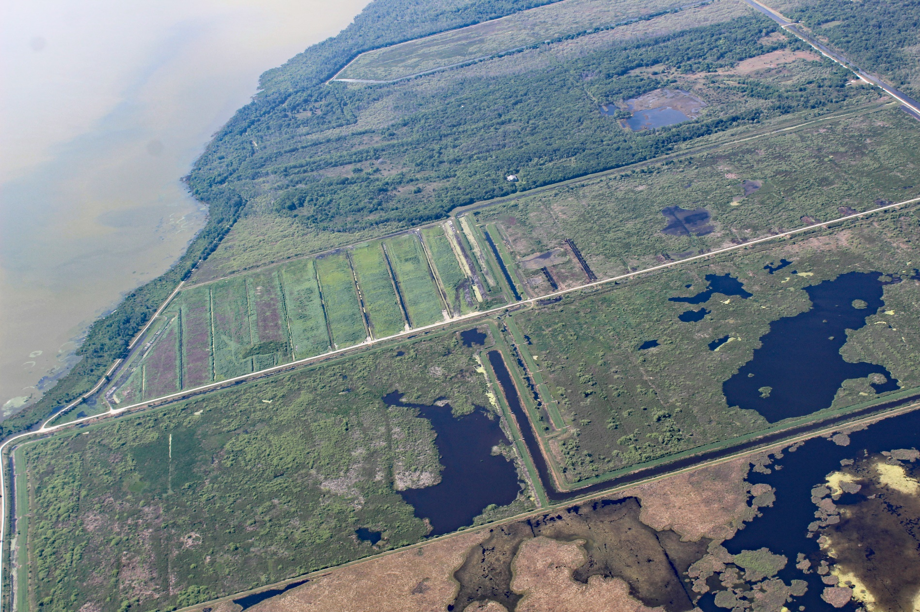
Entire Flow-way - March 2020
Looking Toward the South
B1 CELL DRYING AND PREPING FOR MAINTENANCE
B2 CELL AFTER MAINTENANCE
C1 CELL WET
C2 CELL WET

Slide 3
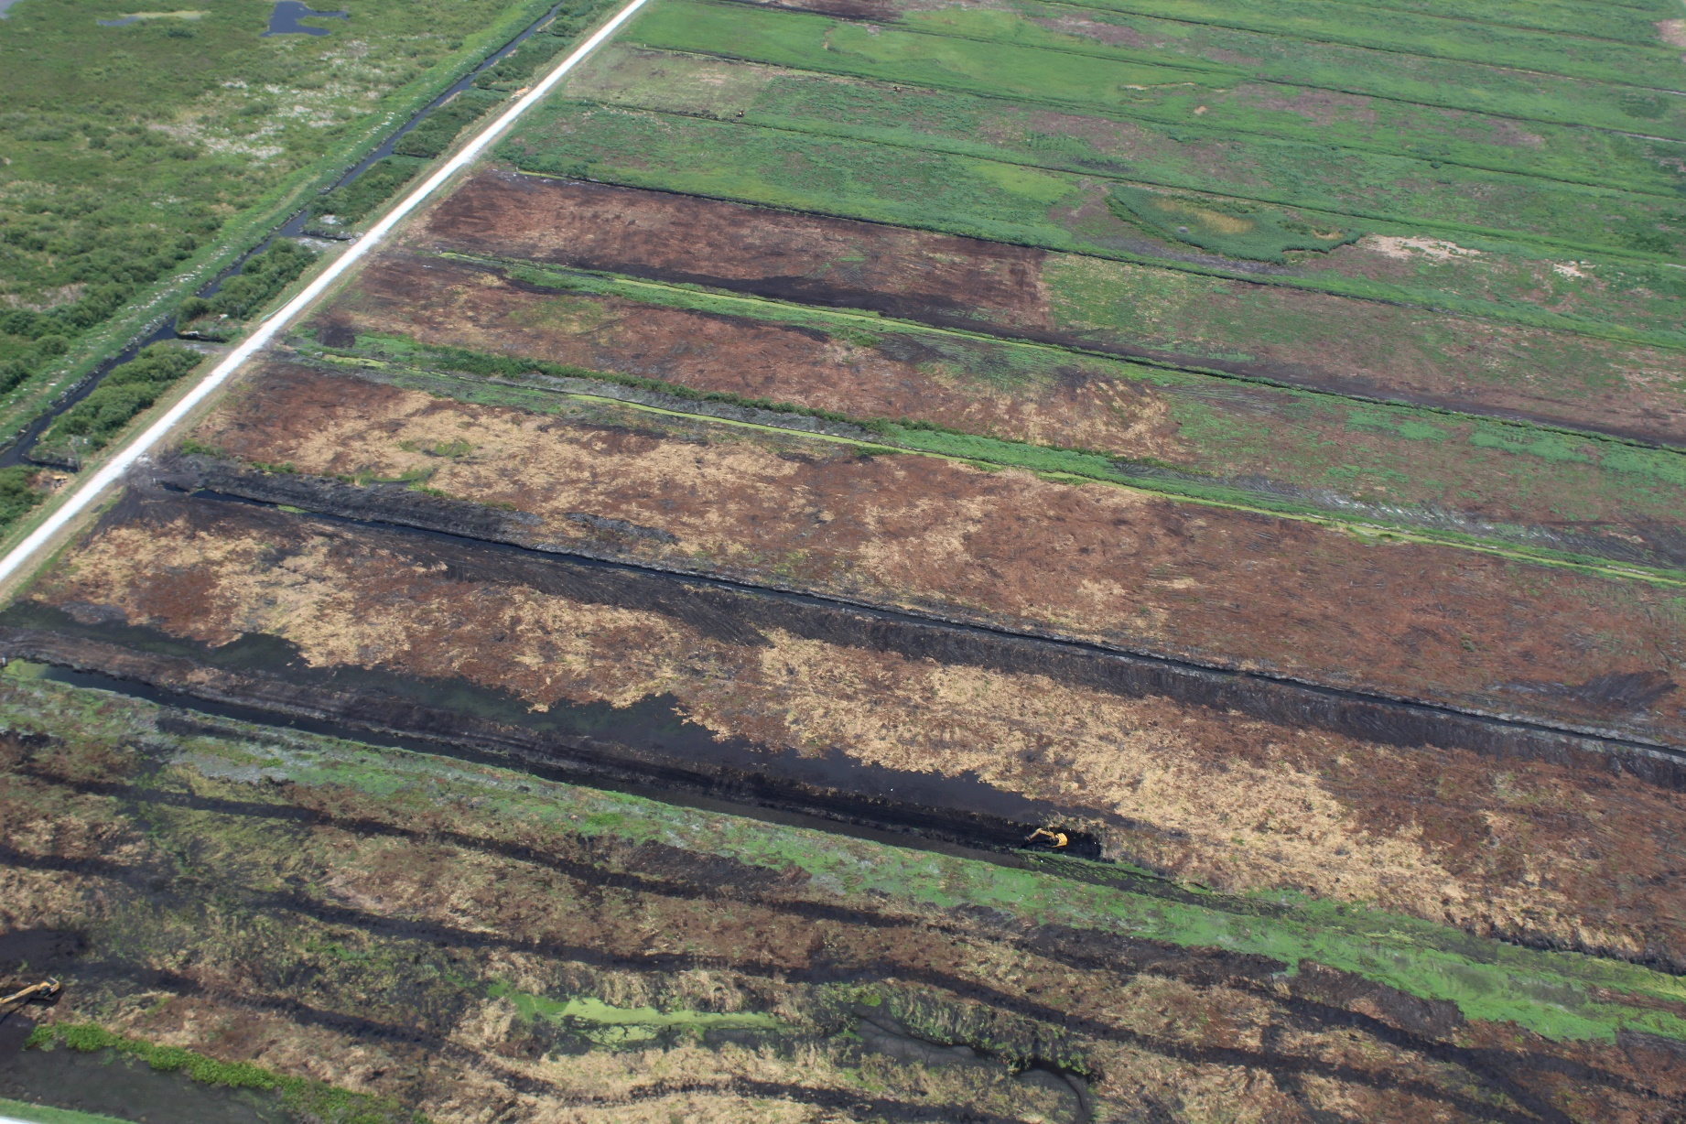
B1 CELL DURING MAINTENANCE – MAY 2020

Slide 4
Lessons Learned about dewatering ditches and structures
It was necessary to excavate each dewatering ditch before vegetation clearing to completely drain the cell. The dewatering ditches were clogged throughout and not working.
Dewatering included removal of structure boards and if needed unclogging pipes so water will flow.
Removing too many boards at one time resulted in frequent clogging of the dewatering ditch structures.
Daily checks of the dewatering ditch structures was required to insure they did not become blocked with vegetation.
Even with dewatering, cells were extremely wet requiring use of mats to clear vegetation in some locations
By opening the ditches, crews were able to work 50% of the cell without mats, almost doubling clearing rates. (in some cells more than 50%)

Slide 5
Lessons learned about vegetation clearing
Each sub cell had to be cleared individually; it was too time consuming to work across the ditches and good chance to get stuck.
It was necessary in some areas to work around areas with standing water to allow for them to dry and then return later to clear the vegetation.
Once the vegetation was excavated/cleared; it was necessary to “rough” grade the sub cells to promote draining and minimize final grading efforts.
Woody vegetation required roots to be excavated, negating use of traditional mechanical vegetation type equipment i.e. mulching equipment.
Root balls and large woody debris was buried within the cell if it was too substantial to be broken up.

Slide 6
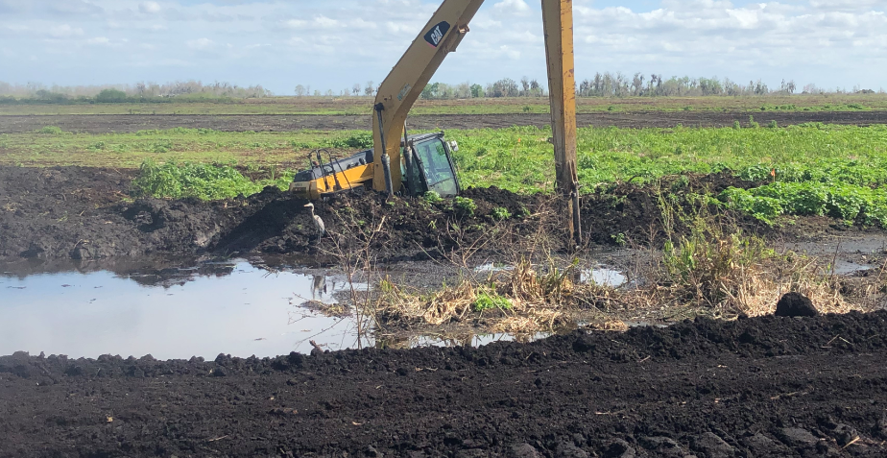
Other Lessons learned
Mounding from previous ditch cleaning/excavation and short-circuiting were evident throughout the dried cells requiring grading to meet the final design requirements.
Both the inlet and outlet ditches were silted in due to sloughing of ditch banks and sediment discharging from the cell. The material was not a solid material and required multiple efforts to remove the material.

