Slide 1

Berkeley City College
Pre-Qualification Conference
RFQ # 20-21/06
Design-Build Services, 2118 Milvia Street
2020 October 13

Slide 2
Agenda
Project Team
Project Location
Project Overview and Scope of Work
Timeline and Schedule
Statement of Qualifications (“SOQ”) Submission Requirements
Scoring
SLBE/SELBE
Request for Proposal (“RFP”) Phase
Q&A

Slide 3
Project Team
Peralta Community College District
  Leigh Sata, Vice Chancellor of General Services
  Atheria Smith, Facilities Planning and Development Director
Financial Services
  Brian Slaughter, Purchasing Director
  John Hiebert, Purchasing
Berkeley City College
  Dr. Angelica Garcia, President, Berkeley City College
  Shirley Slaughter, Director of Business and Administrative Services

Slide 4
Project Team
Bond Program Management
  Keith Kajiya
  Sharon Serrano
  Ray Loving
  Cynthia Martin
  Shonda Scott
  Shonnell Frost-Gibbs
  Kelly Conley
Construction Manager
  Bob Parks
  Jeremy Judd
  Summer Naranjo

Slide 5
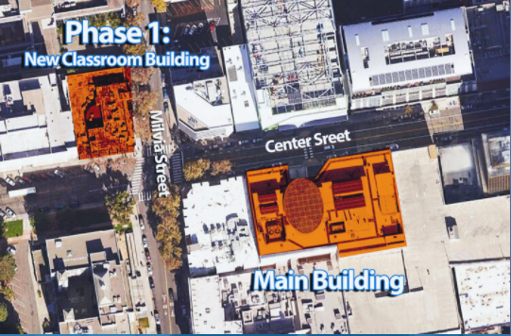
Project Location
2118 Milvia Street, Berkeley CA

Slide 6
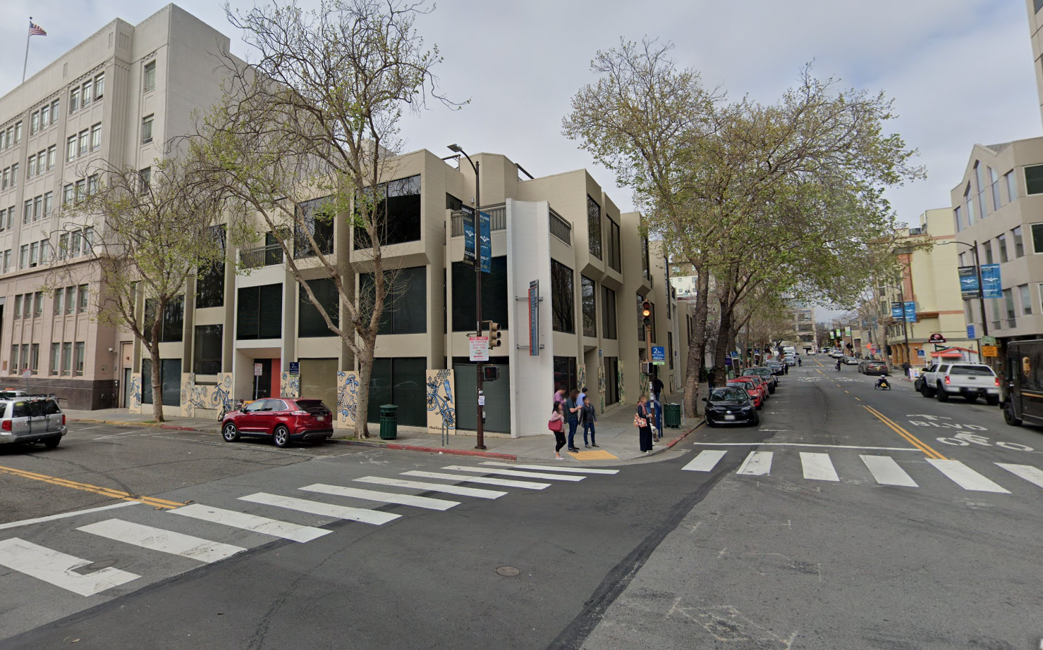
Project Location
2118 Milvia Street, Berkeley CA

Slide 7
Project Overview
Demolition of existing three (3) story building (roughly 25,000 sq. ft.)
Construction of a new six (6) story building (roughly 60,000 sq. ft.)
Approximate Building Footprint is 10,000 sq. ft.
Total Design-Build Target Budget (Inc. escalation) = $63,000,000
Total District Project Budget (Inc. Escalation and Soft Costs) = $83,851,707

Slide 8
Scope of Work
Total Gross Square Footage – 60,000
Demolition of Existing 2118 Milvia Street
Construct a Complete Building – not an outpost
Expand Classrooms (replace leased space at 2000 Center + 10)
Faculty Offices (full and part time)
Administrative Offices (Dean + College Administration)
Art Studios
Outdoor Roof Space
Student Activities and Services
  Health Center
  Veterans
  Multi-Cultural Center
  Bookstore
  Student Lounge
  Learning Resource Center

Slide 9
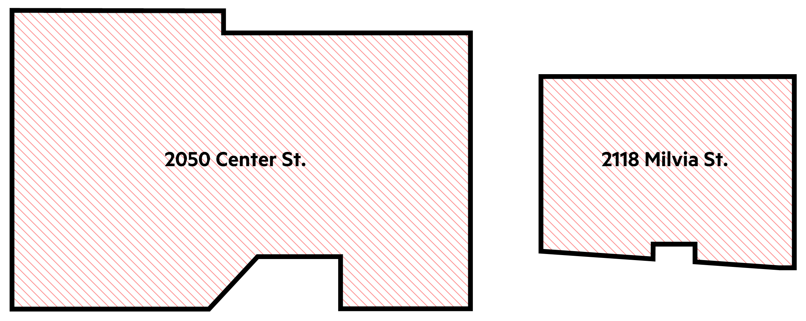
SIZE COMPARISON
BCC CAMPUS EXPANSION
DIAGRAM PLANS

Slide 10
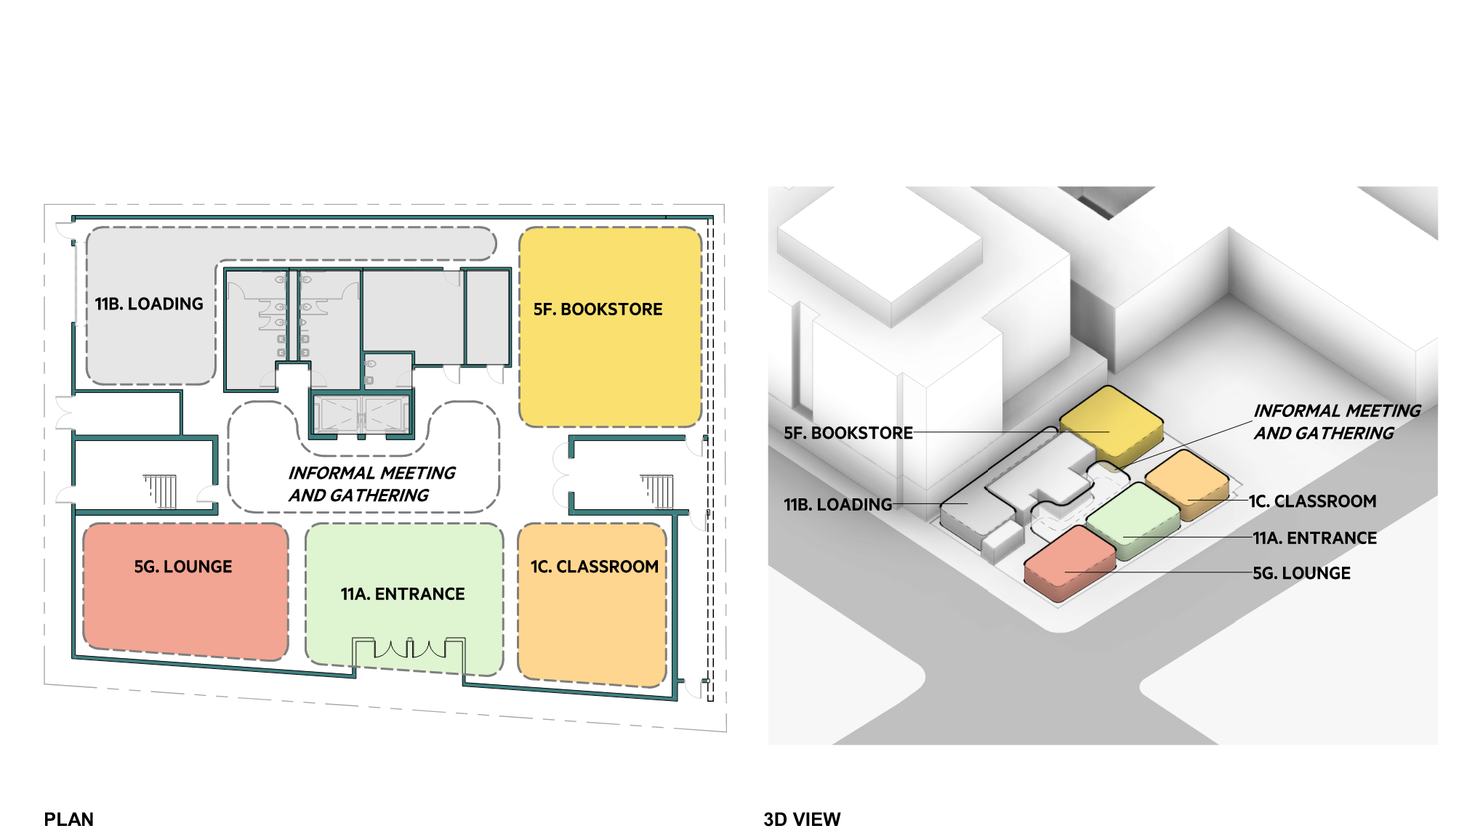
FIRST FLOOR
BCC CAMPUS EXPANSION
DESIGN CRITERIA

Slide 11
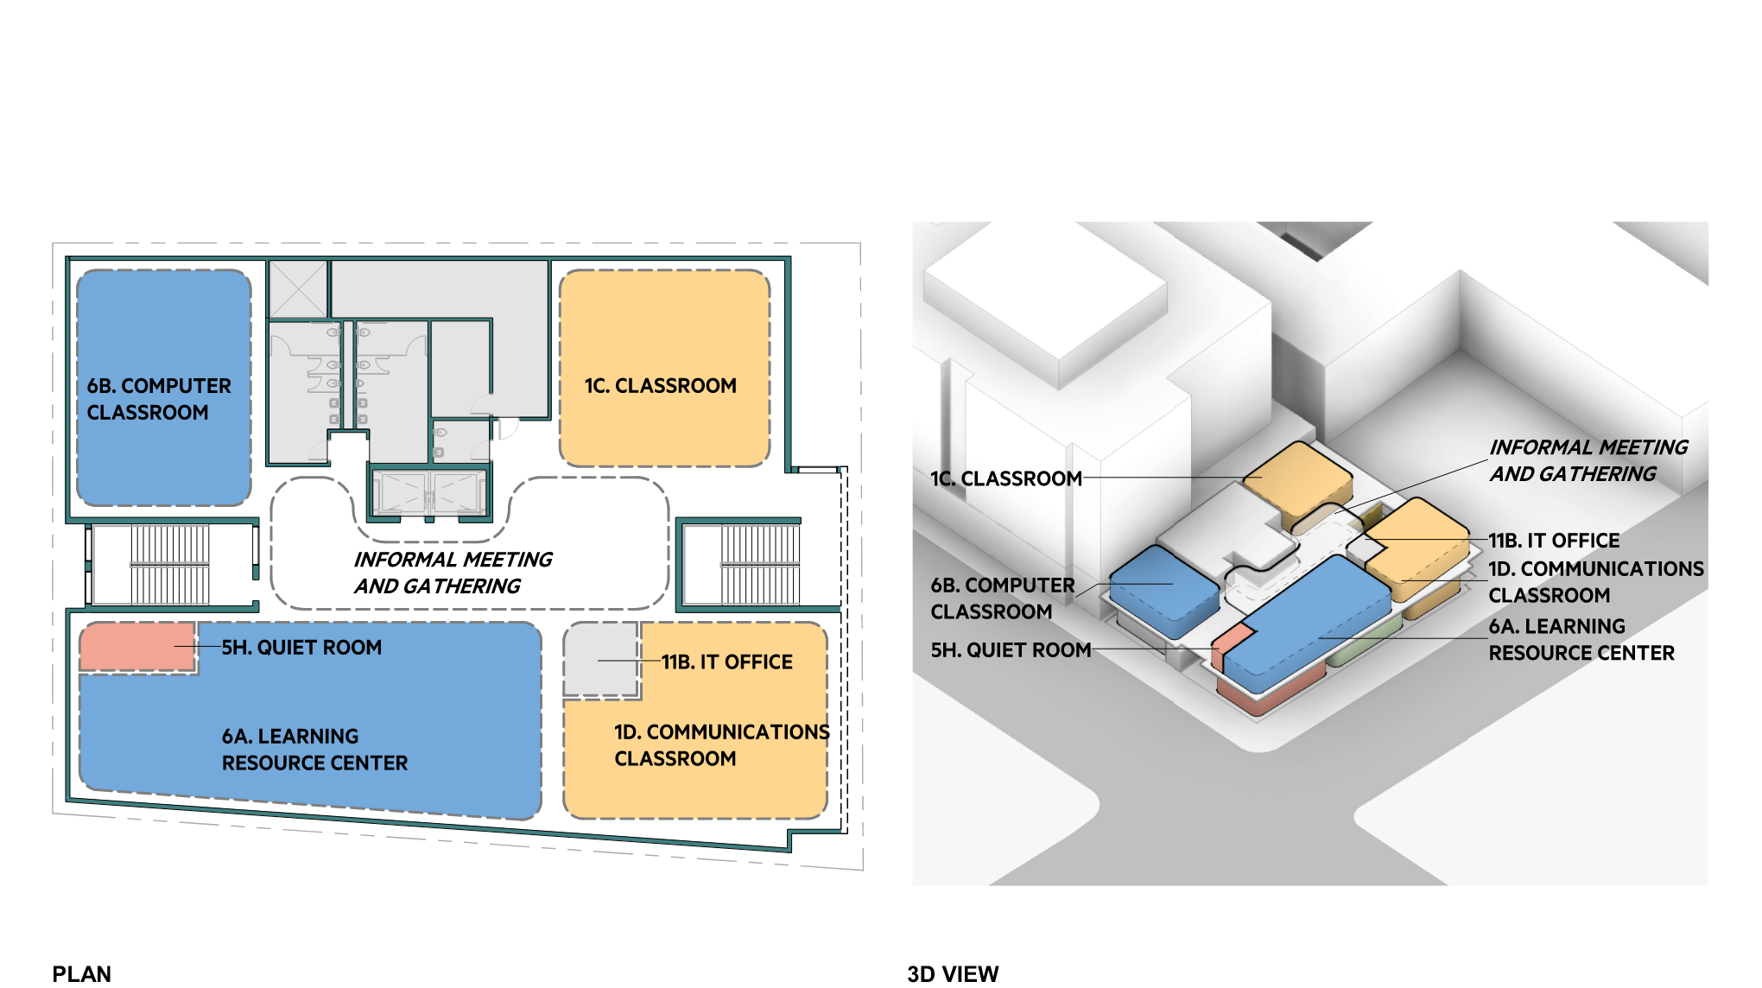
SECOND FLOOR
BCC CAMPUS EXPANSION
DESIGN CRITERIA

Slide 12
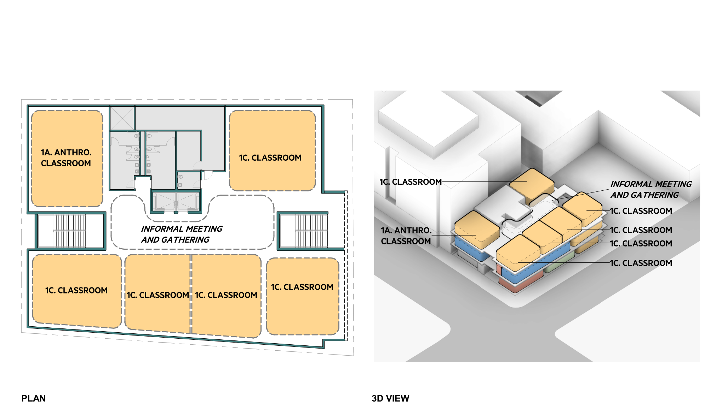
THIRD FLOOR
BCC CAMPUS EXPANSION
DESIGN CRITERIA

Slide 13
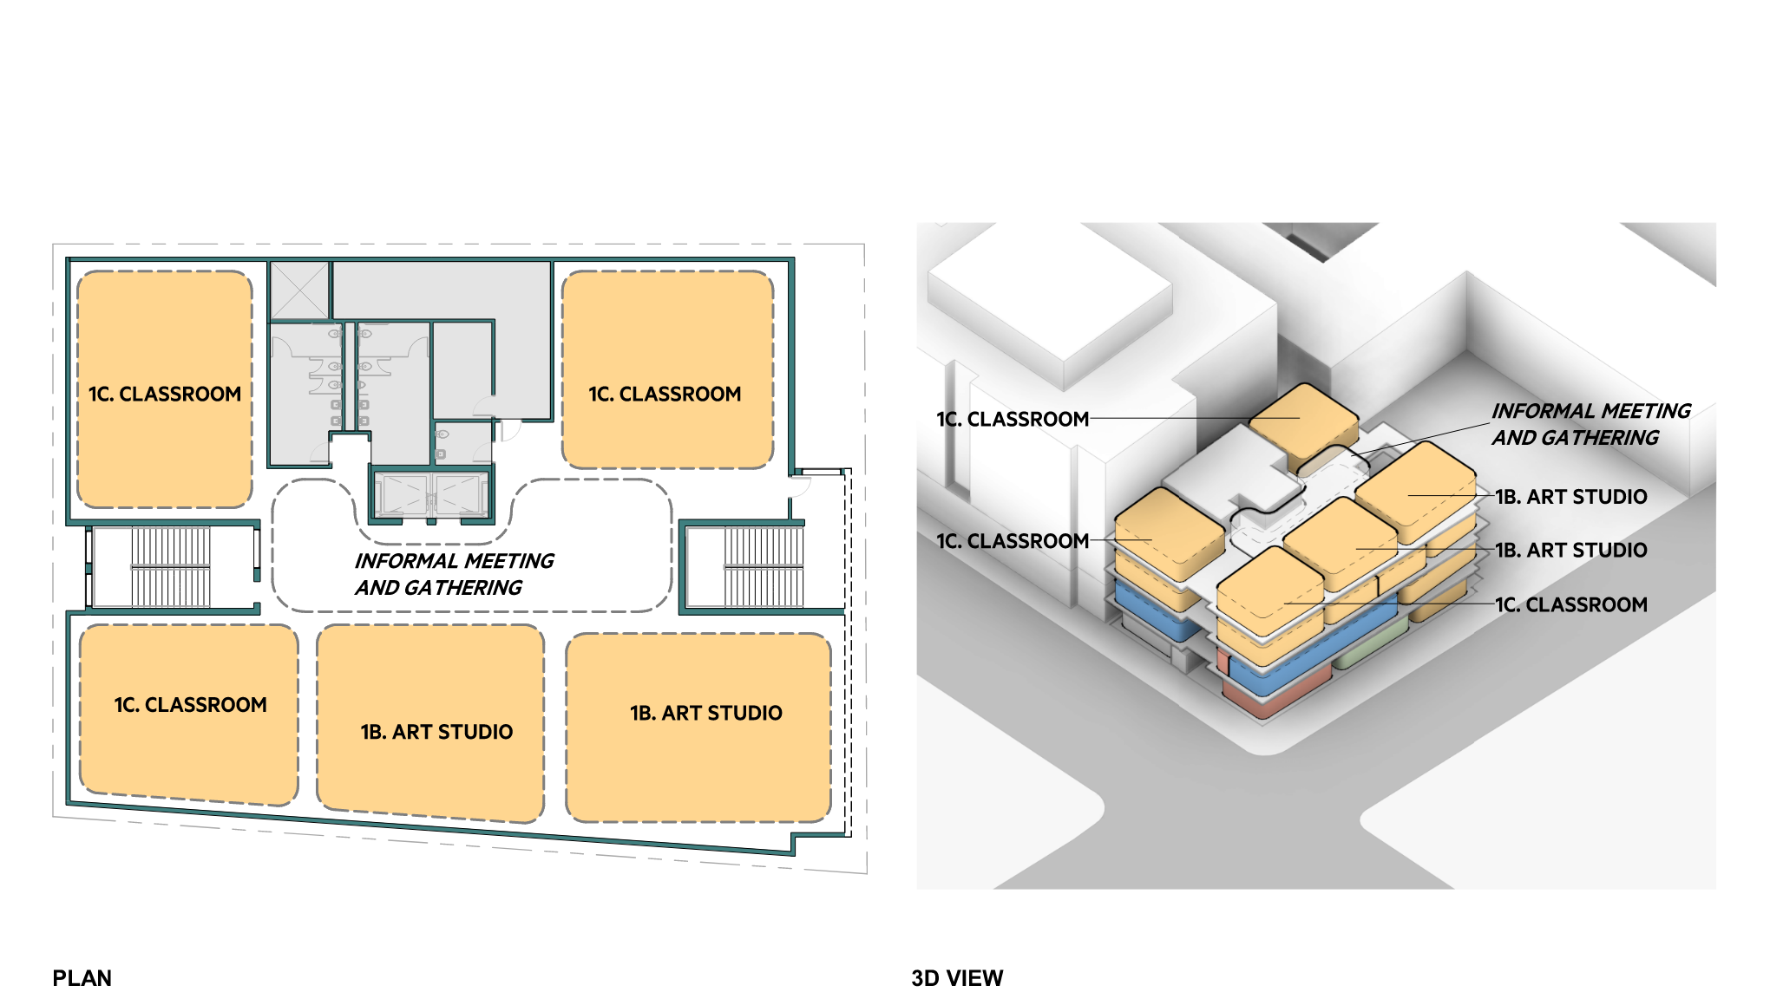
FOURTH FLOOR
BCC CAMPUS EXPANSION
DESIGN CRITERIA

Slide 14
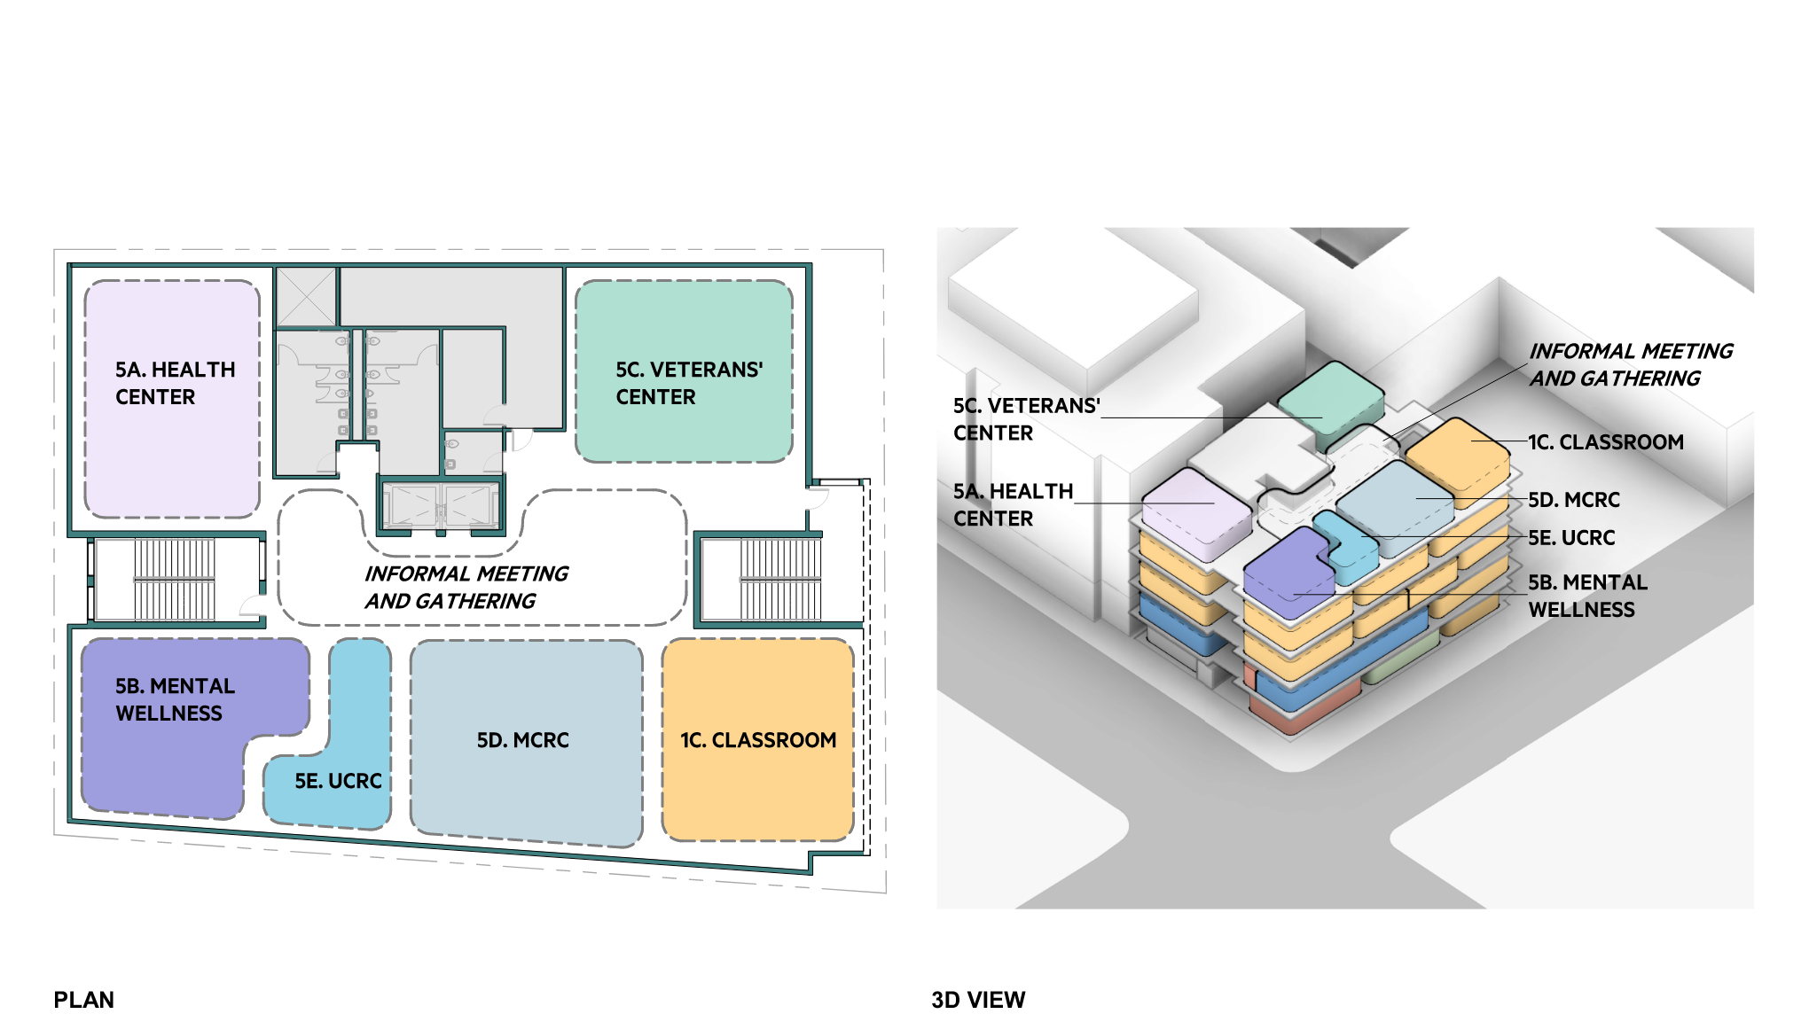
FIFTH FLOOR
BCC CAMPUS EXPANSION
DESIGN CRITERIA

Slide 15
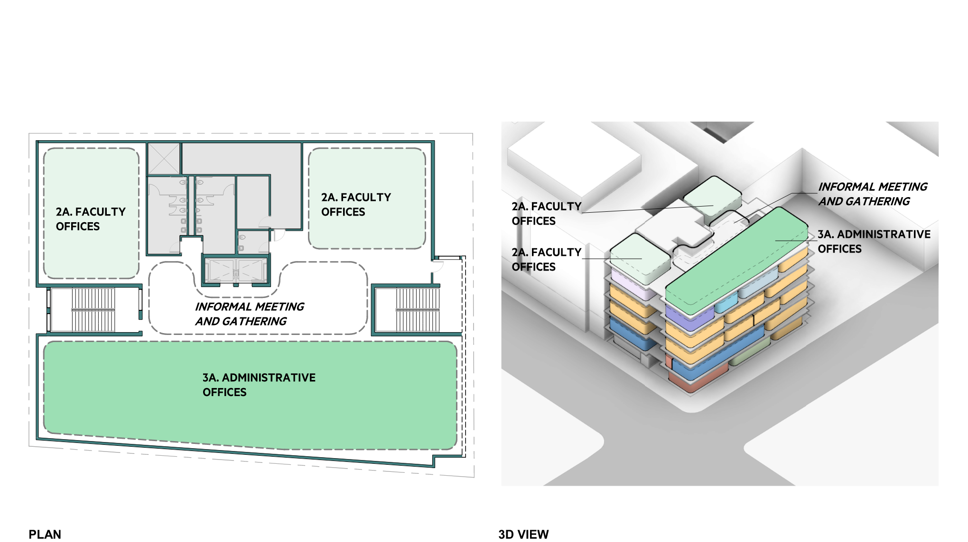
SIXTH FLOOR
BCC CAMPUS EXPANSION
DESIGN CRITERIA

Slide 16
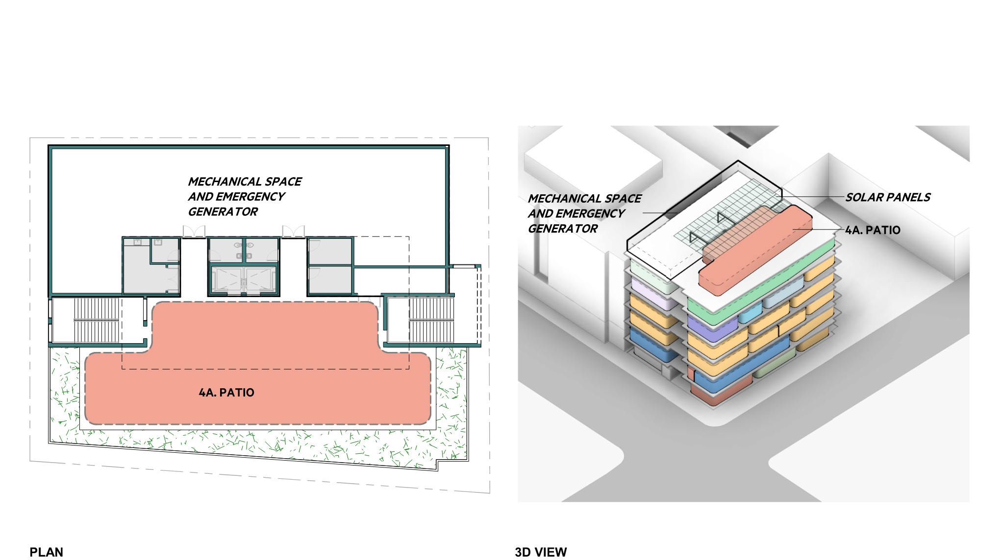
SEVENTH FLOOR
BCC CAMPUS EXPANSION
DESIGN CRITERIA

Slide 17
Timeline and Schedule
October 2, 2020 | Release of RFQ # 20-21/06
October 13, 2020, 10:00 A.M. | Mandatory Pre-Qualification Video Conference
October 27, 2020, 2:00 P.M. | Last day to receive written questions from respondents
November 3, 2020, 2:00 P.M. | Last day for District to issue addenda or answer questions
November 6, 2020, 2:00 P.M. | Deadline for submissions in response to RFQ
Late-November 2021 to Late-January 2021 | (Anticipated) Request for Proposal (“RFP”) Phase
Q1 - 2021 | (Anticipated) Design-Build BOT Approval & Contract Award
Q2 2021 – Q1 2022 | (Anticipated) Collaboration and Design Phases
Q1 2022 – Q4 2022 | (Anticipated) Division of the State Architect (DSA) Review
Q4 2022 – Q4 2024 | (Anticipated) Construction and Closeout Phases

Slide 18
Submission Requirements
Statement of Qualifications (“SOQ”)
  Submit Electronically: https://build.peralta.edu/vendor-registry
The District intents to pre-qualify and shortlist up to three (3) highest scoring respondents using a standard template request for statements of qualifications, as outlined in Appendix B.

Slide 19
Submission Requirements
Appendix B – Standard Template For Statement of Qualifications
  Section I – Information about Design-Build Entity Members
    Pass/Fail
  Section II – Licensing and Registration
    Pass/Fail
  Section III – Performance History
    16 Points
  Section IV – Bonds and Insurance
    Pass/Fail
  Section V – Safety
    10 Points

Slide 20
Submission Requirements
Appendix B – Standard Template For Statement of Qualifications
  Section VI – Project Experience and References
    32 Points
  Section VII – Relevant Experience of Key Personnel
    32 Points
  Section VIII – SLBE/SELBE Compliance
    10 Points
  Section IX – Skilled and Trained Workforce Compliance
    Pass/Fail
  Section X – Exhibits
    Pass/Fail

Slide 21
Submission Requirements
SOQ Highlights
  Section VI – Project Experience and References
    32 Points
  Both the General Contractor and the Architect of Record shall complete both project reference forms and tables:
    Three (3) comparable projects from each firm for each project type listed below
    Exhibit A-1 – Design-Build Project References (3 projects)
      Excel Table A-1.1
    Exhibit A-2 – California Community College References (3 projects)
      Excel Table A-2.1

Slide 22
Submission Requirements
SOQ Highlights
  Section VII – Relevant Experience of Key Personnel
    32 Points
  Complete Exhibit B – Excel Table
  Attach resumes, not to exceed 1 page each for each of the Key Personnel
  Provide an Organizational Chart

Slide 23
Submission Requirements
SLBE/SELBE
  Section VIII – SLBE/SELBE Compliance
    10 Points
  Complete Exhibit G – SLBE/SELBE Program and Self Certification Affidavit for any firms who meet the District’s definition of an SLBE or SELBE
  DBE to provide a 1 page written narrative describing how the DBE will engage, encourage, and provide equal access to businesses (such as professional services, subcontractors, suppliers, vendors) to complete for opportunities on this project.

Slide 24
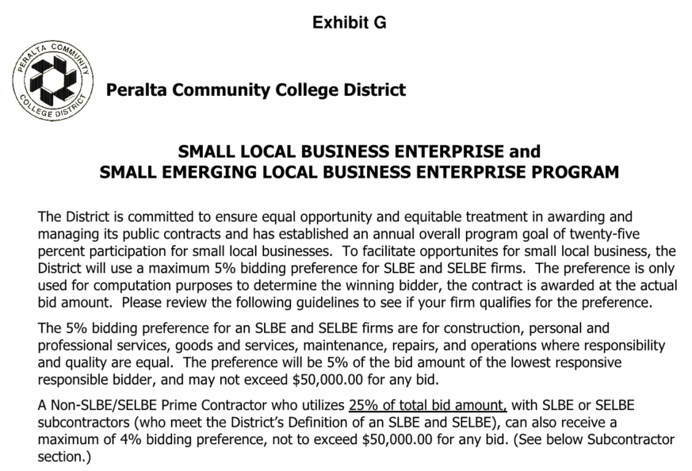
Submission Requirements
Exhibit G - SLBE/SELBE (Snapshot)
  Be sure to read the entire Exhibit G

Slide 25
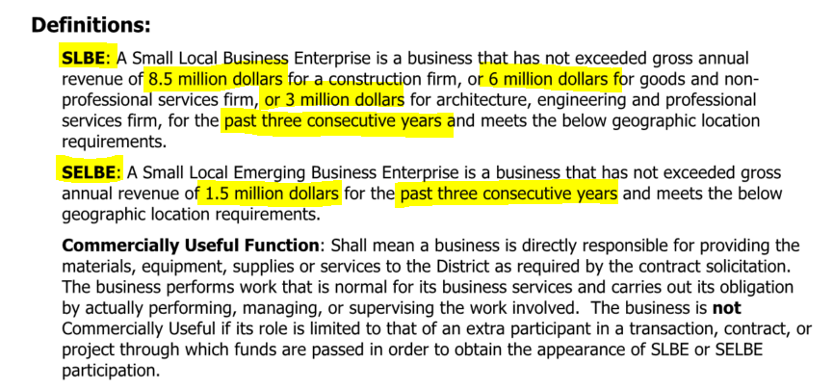
Submission Requirements
Exhibit G - SLBE/SELBE (Snapshot)

Slide 26
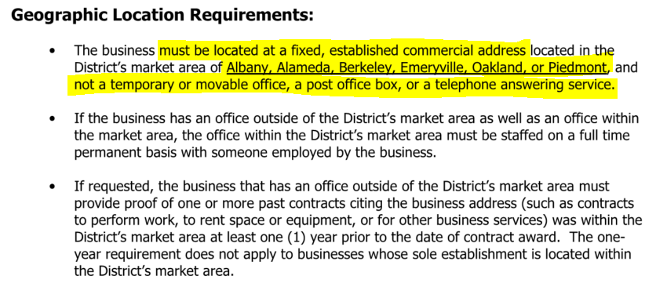
Submission Requirements
Exhibit G - SLBE/SELBE (Snapshot)

Slide 27
Design-Build Competition (RFP Phase)
The District will issue an RFP to the prequalified and shortlisted respondents to submit proposals for the Project.
The District will use a best value selection method for evaluating proposals.
Shortlisted respondents receiving the RFP that submit a responsive proposal but who are not selected, will be eligible to receive a stipend not to exceed Twenty Five Thousand Dollars ($25,000) for their efforts.

Slide 28



Questions?
2020 October 13

