Slide 1
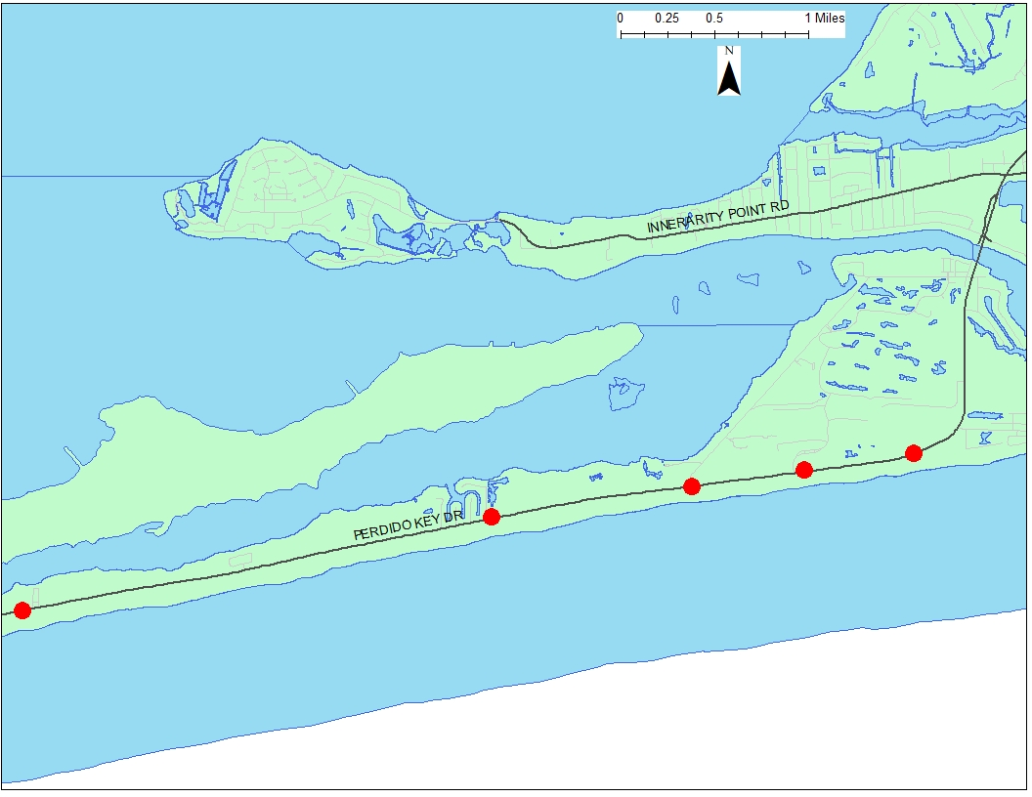
LOCATION MAP – MARKED PEDESTRIAN CROSSINGS* ON PERDIDO KEY DRIVE
14300 BLOCK PERDIDO KEY DRIVE (BEACH ACCESS #2)
14000 BLOCK PERDIDO KEY DRIVE (BEACH ACCESS #3 AT RIVER ROAD)
13700 PERDIDO KEY DRIVE (VILLAGIO COMPLEX)
15301 PERDIDO KEY DRIVE (FIRE STATION COMMUNITY CENTER)
17100 PERDIDO KEY DRIVE (TOM THUMB STORE)
*EXCLUDES ANY AMENITIES ASSOCIATED WITH FLORA-BAMA LOCATION

Slide 2
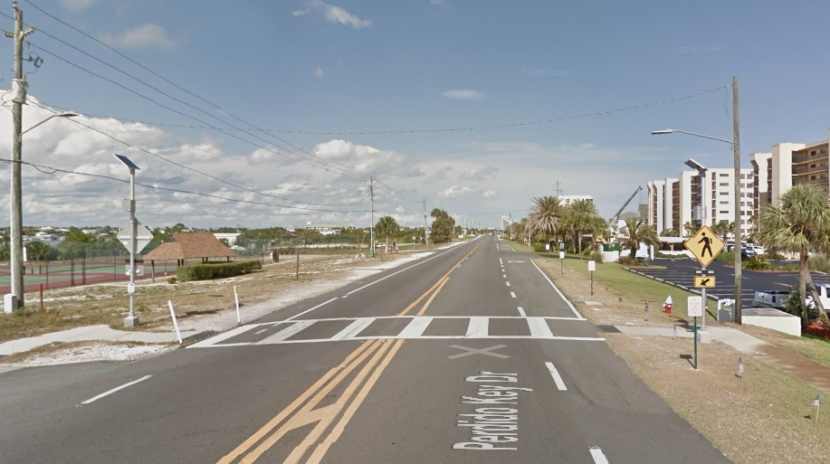
TOM THUMB STORE PEDESTRIAN CROSSING VIEWING EAST ON PERDIDO KEY DRIVE

Slide 3
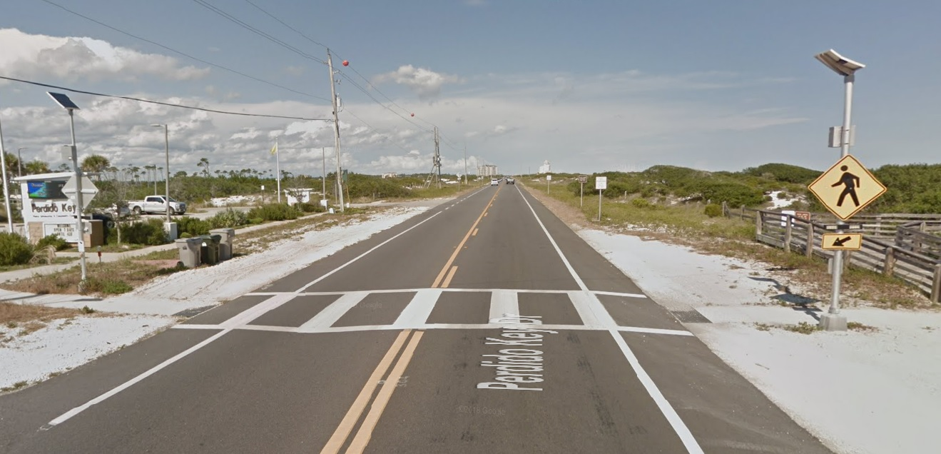
FIRE STATION PEDESTRIAN CROSSING
VIEWING EAST ON PERDIDO KEY DRIVE

Slide 4
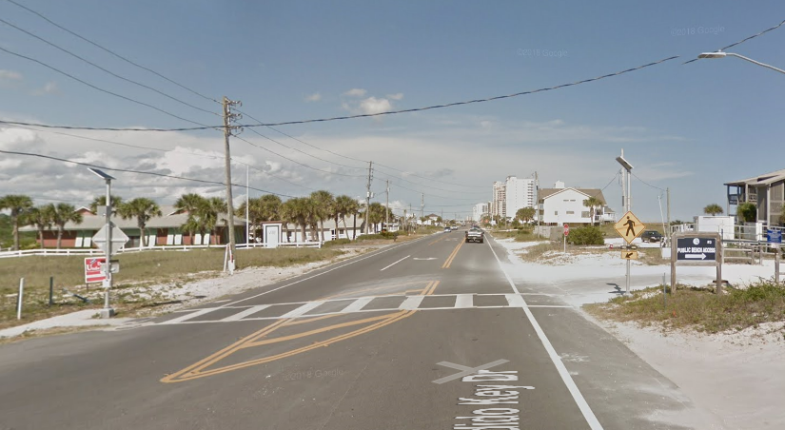
BEACH ACCESS #3 PEDESTRIAN CROSSING AT
RIVER ROAD VIEWING EAST ON PERDIDO KEY DRIVE

Slide 5
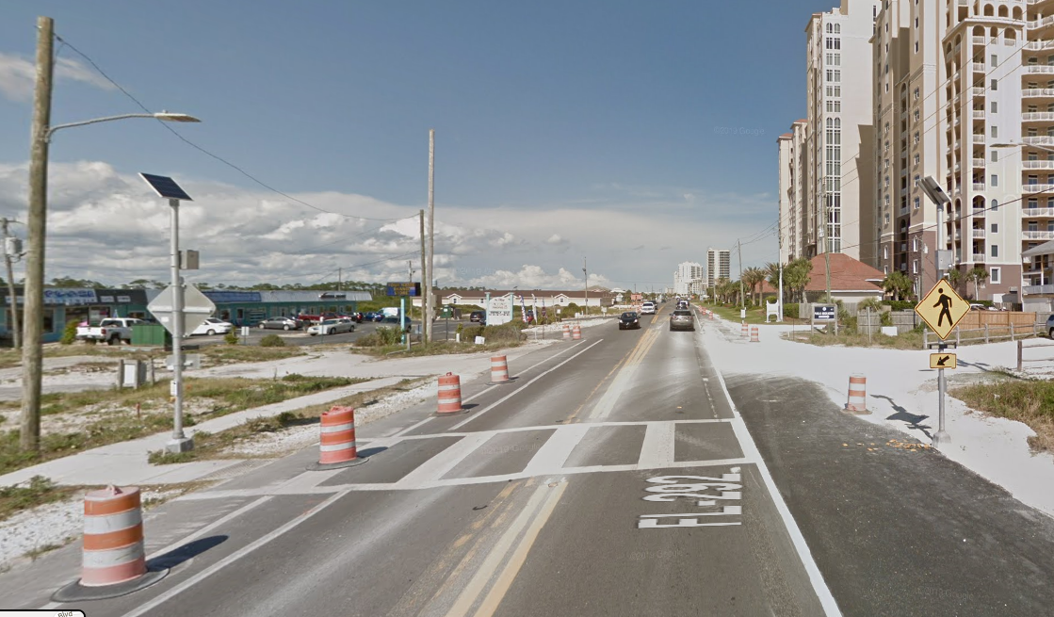
BEACH ACCESS #2 PEDESTRIAN CROSSING
VIEWING EAST ON PERDIDO KEY DRIVE

Slide 6
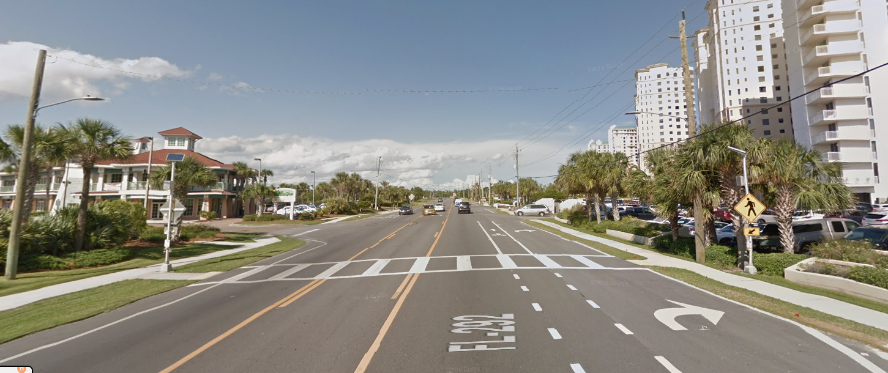
PEDESTRIAN CROSSING AT VILLAGIO RETAIL COMPLEX
VIEWING EAST ON PERDIDO KEY DRIVE

