Slide 1
YV High School JV Baseball Field fencing Specifications
7600 Sage Avenue Yucca Valley ca
92284
12 ft. high ,10 ft.& 8 ft. high chain-link fencing
2 7/8 sch 40 end, corner & gate post
2 3/8 sch 40 line post set 10 ft. on center
10 ft. high fencing to receive a middle rail
12 ft. high fencing to receive two evenly spaced middle rails
12 ft. high back-stop fencing two evenly spaced middle rails and bottom rail
Post footings for the above heights of fencing to be 12" in dia. x 36" deep concrete footings
6 ft. high & 4 ft. high chain-link fencing
2 7/8 sch 40 end, corner , & gate post
2 3/8 sch 40 line post set 10 on center
Post footings for the above heights to be 8" in dia. x 36" in deep concrete footings
7 gage coil bottom tension wire to be installed on all fence heights ( 12’ section of back-stop will have bottom rails)
Top rail, bottom and mid rails to be 1 5/8 sch 40 pipe
All materials to be galvanized
Concrete mix. 2500 psi

Slide 2
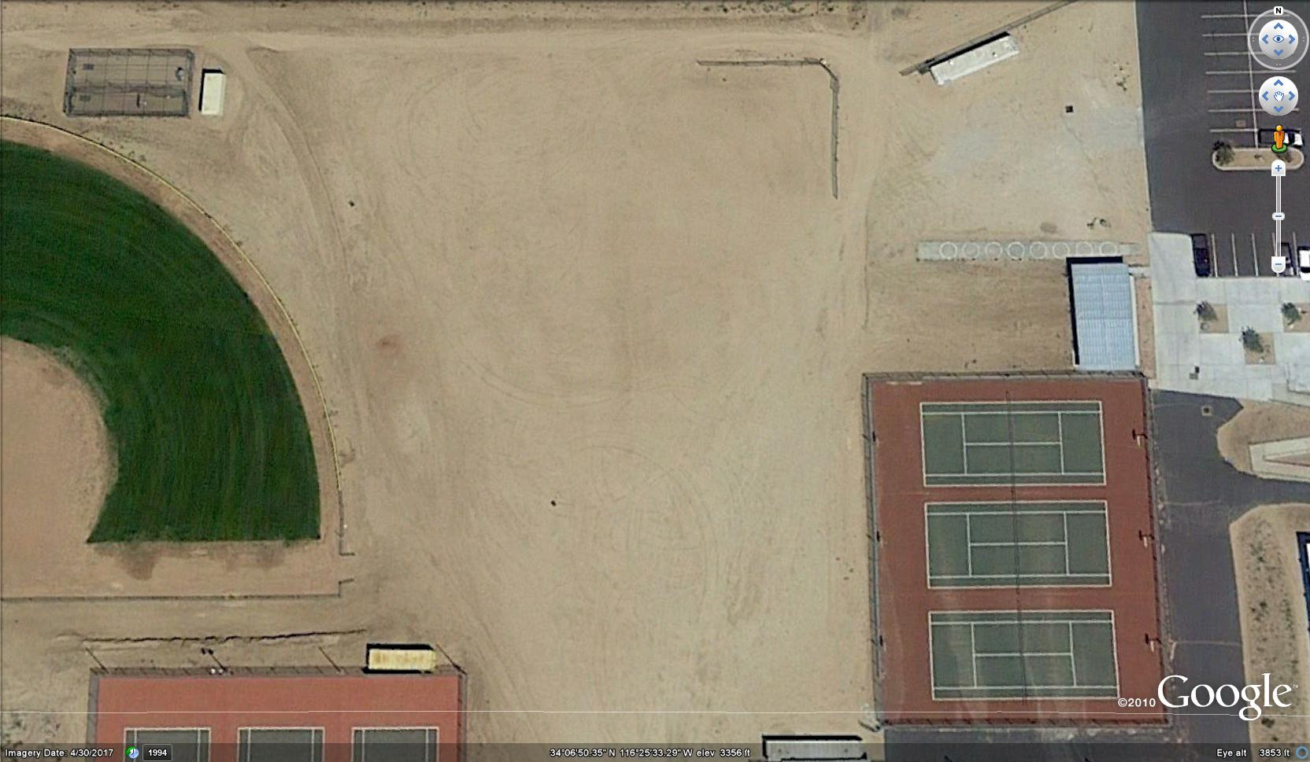
300’
275’
N
W
E
S
241’
275’
275’
300’

Slide 3
Existing grade = -33 ”
Existing grade = -15 ”
Elevation= 0 ”
Elevation= 0 ”
N
10’
W
E
S
Existing grade = 0 ”
25’ Slope 0” to tennis courts
10’ Slope 0” to +15 “
Elevation= +0 ”
Existing grade = +76”
10’ Slope 0” to +76 “

Slide 4
229’- 6’ fence
60’- 12’ Backstop fence
76’- 10’ fence
N
W
E
S
76’- 6’ fence
178’- 12’ fence
12’ FENCE
10’ FENCE
8 ’ FENCE
6’ FENCE
4’ FENCE
256’- 10’ fence

Slide 5

20’
20’
20’
N
W
E
3’X6’
3’X6’
S
10’
10’
30’
30’
3’X6’
3’
3’
3’X6’
8’
8’
12’ FENCE
70’
70’
10’ FENCE
8 ’ FENCE
6’ FENCE
4’ FENCE
GATE
GATE

Slide 6
6’
12’
N
10’
W
E
S
6’
12’
10’
282’

