Slide 1

Sierra County Regional Dispatch Authority
Building Options at Fire Department

Slide 2
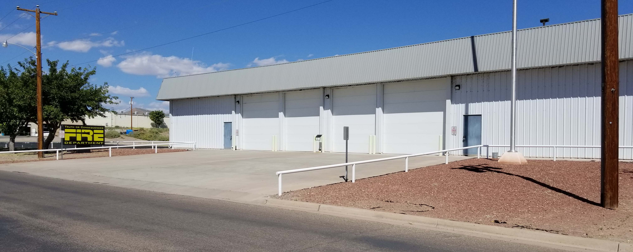
Fire Department
Truth or Consequences Fire Department built a new complex in 2001 at 310 East 9th Street. This complex was setup to house an EOC/Dispatch Center in the same building as the Fire Department.
Truth or Consequences Fire Department has authorization from the State Fire Marshal’s Office to allow SCRDA to operate out of this facility.

Slide 3
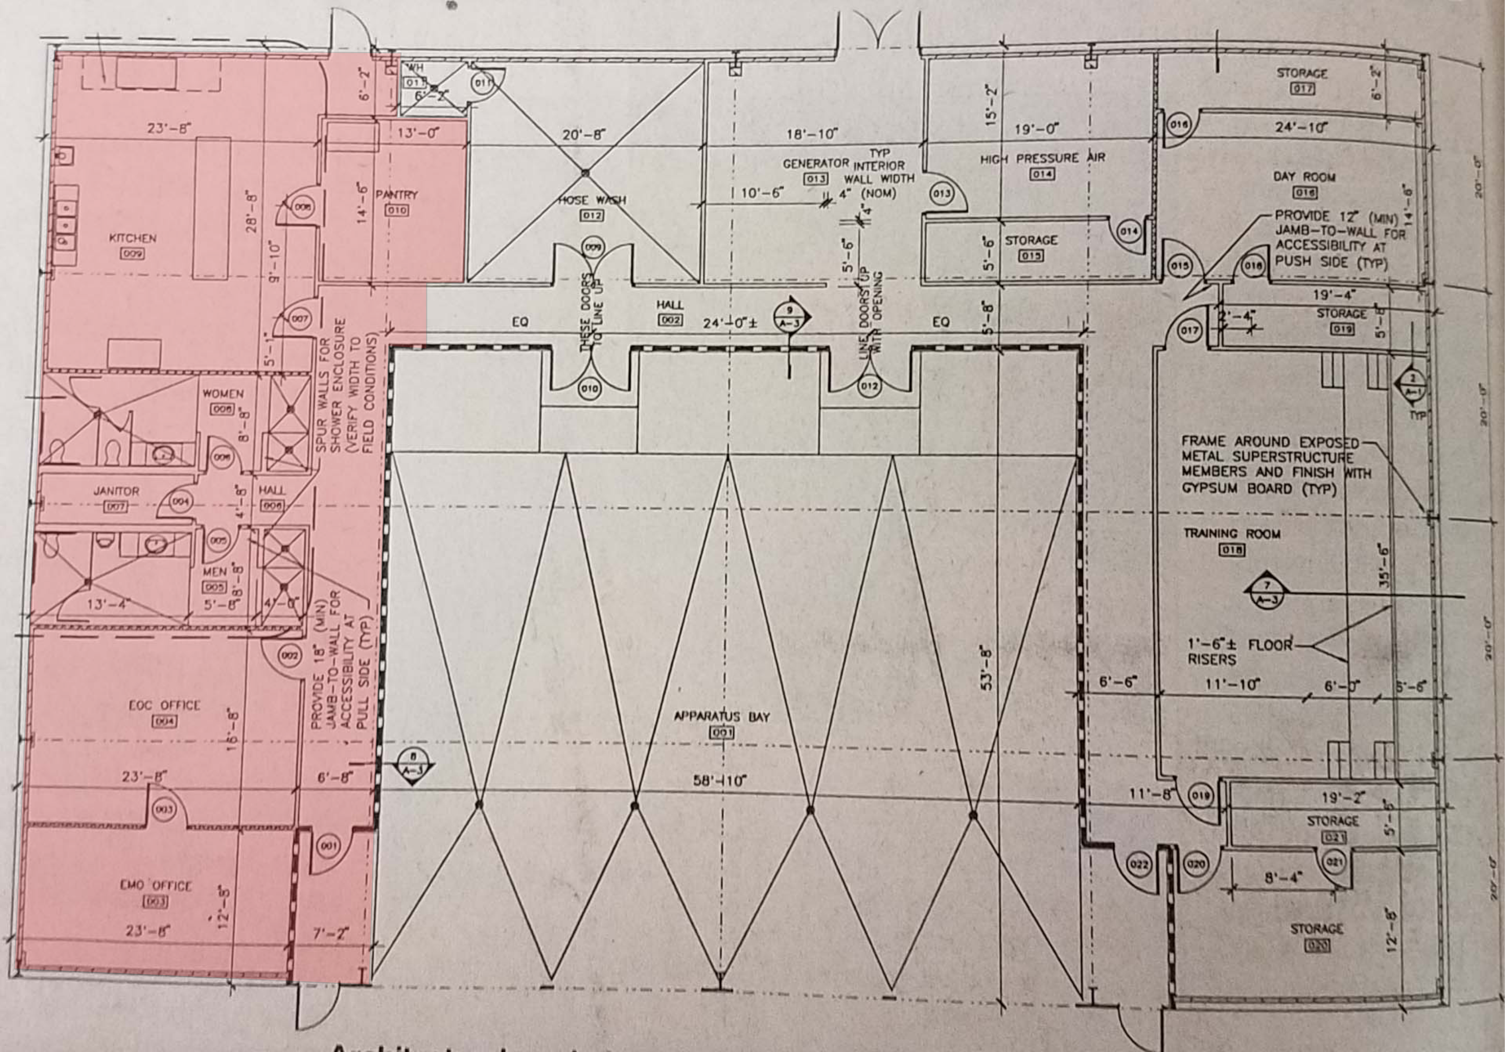

Slide 4
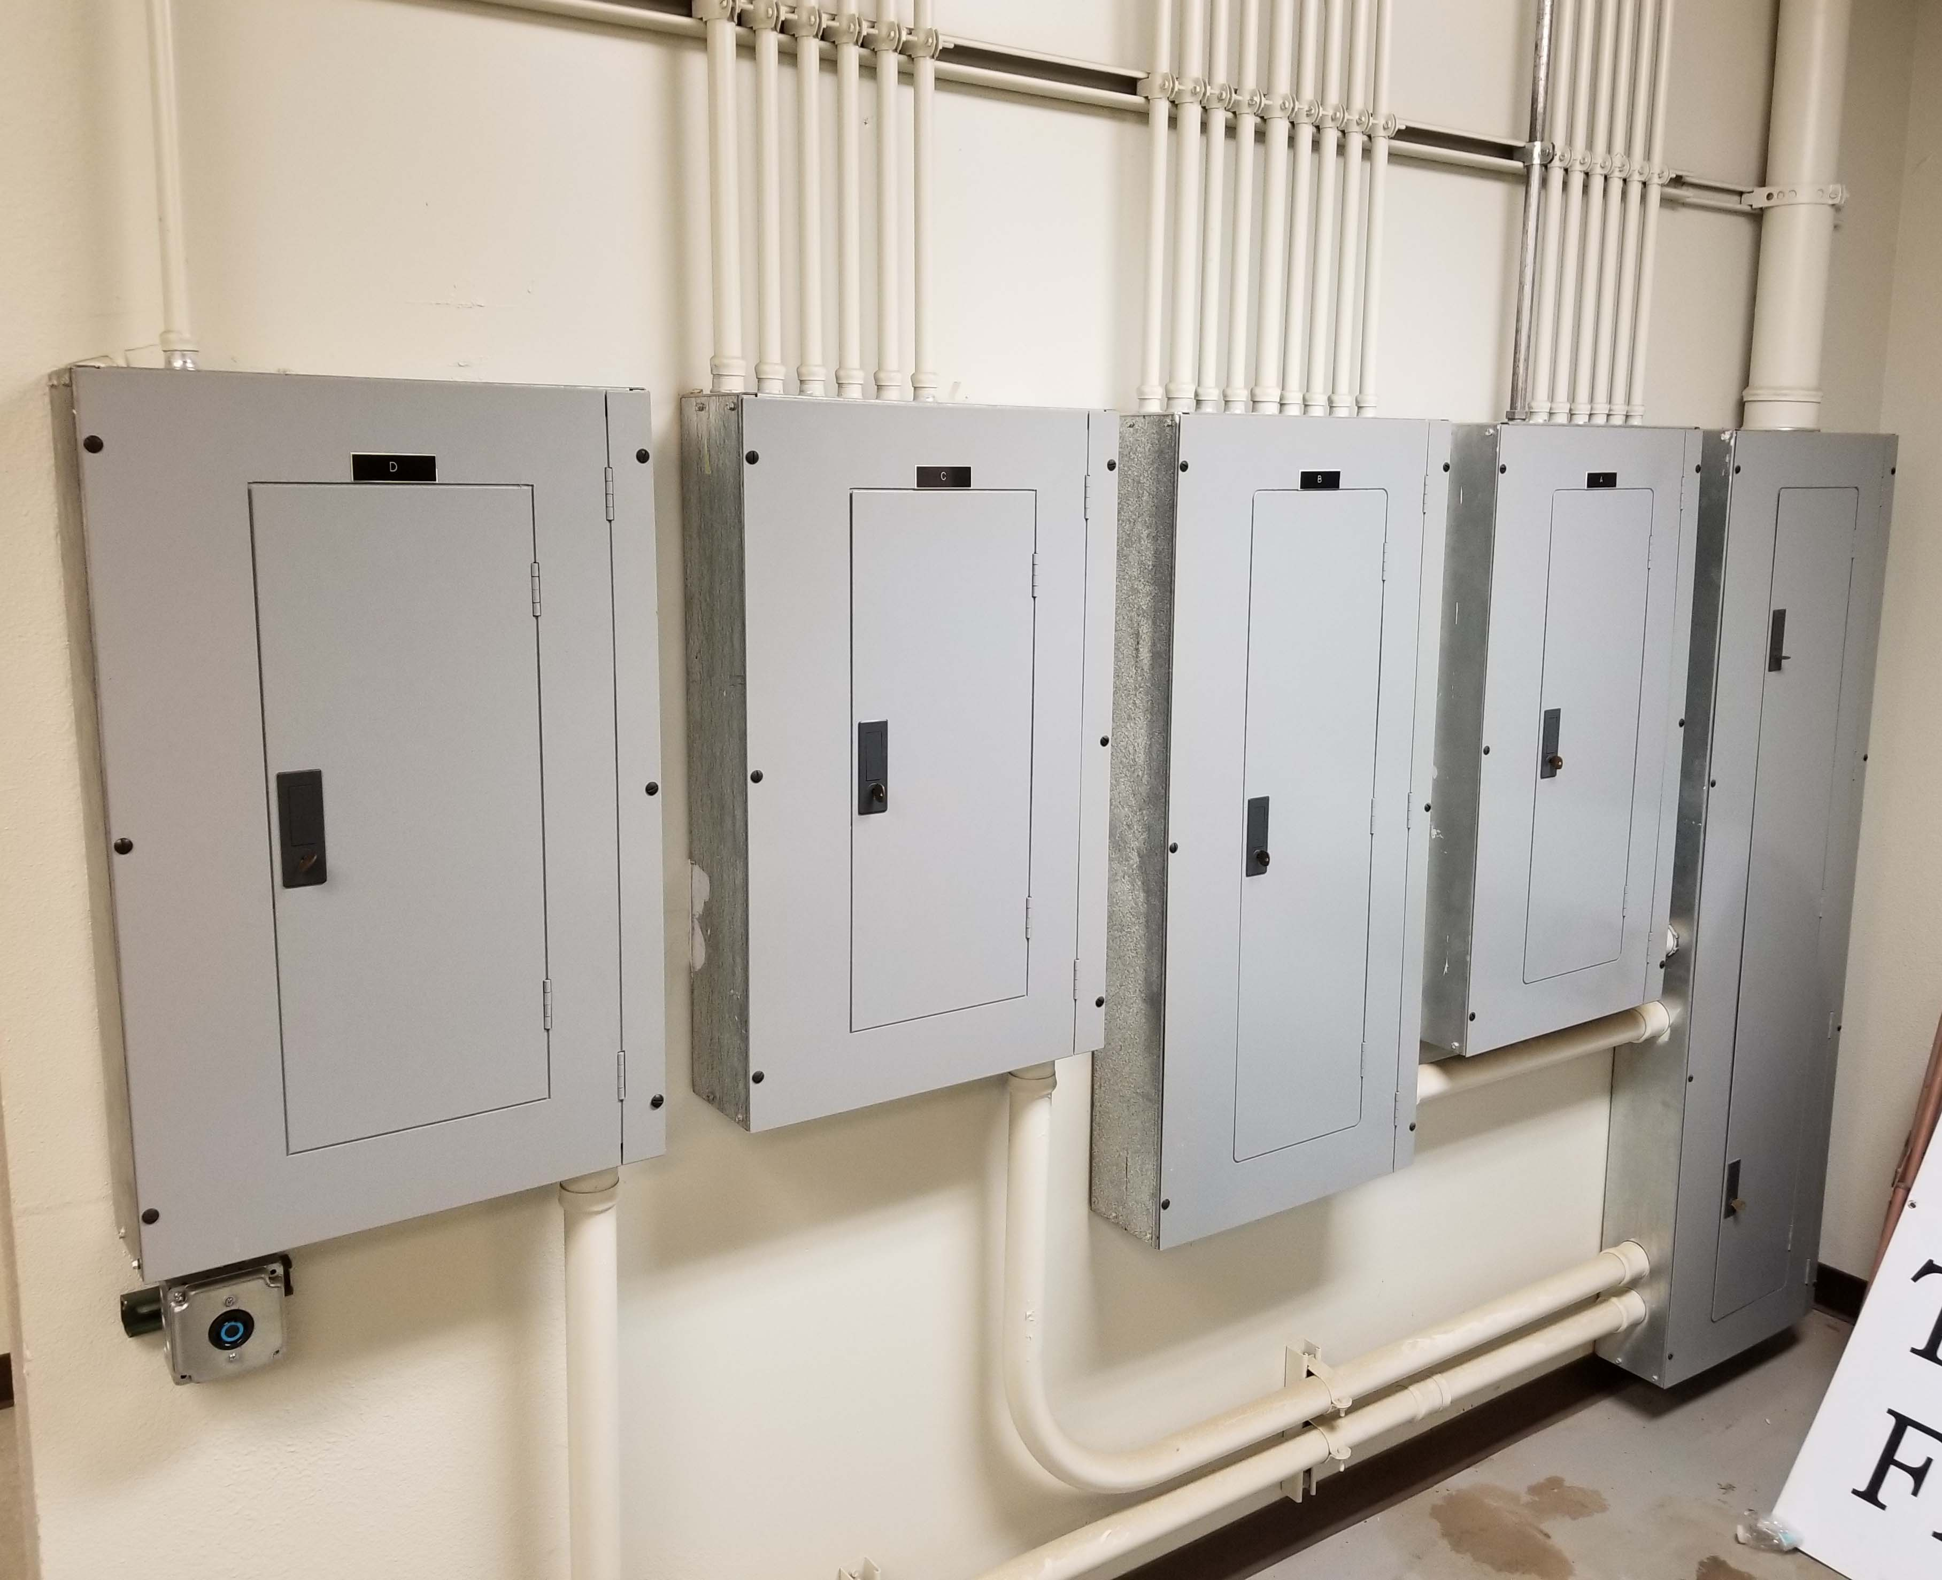
400 amp
Capacity

Slide 5
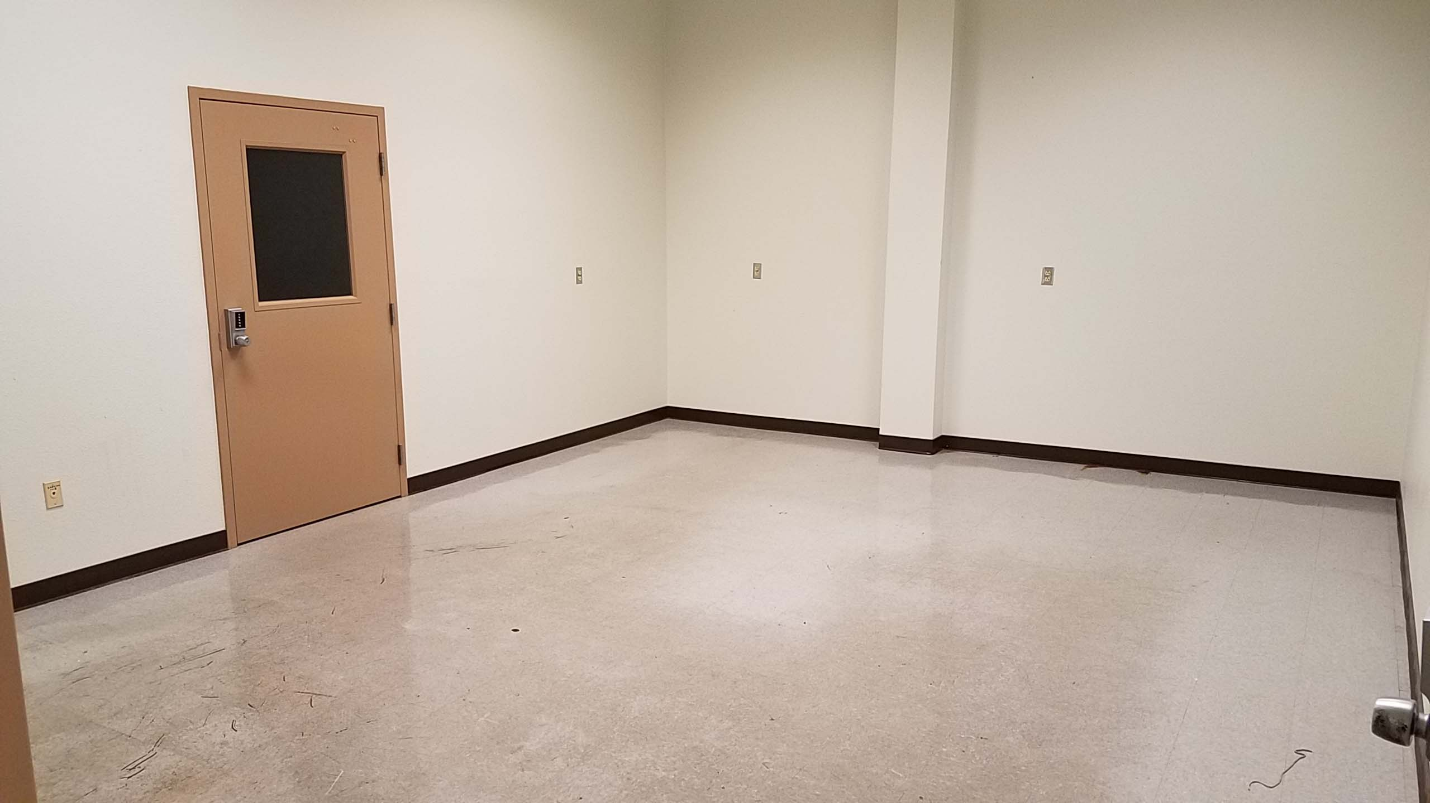
New Dispatch Room (400 sq. ft.)

Slide 6
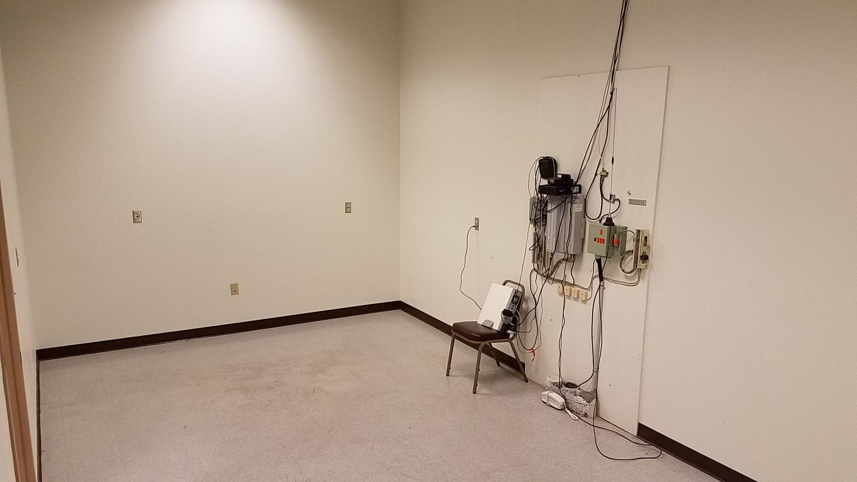
New Radio Room (300 sq. ft.)

Slide 7
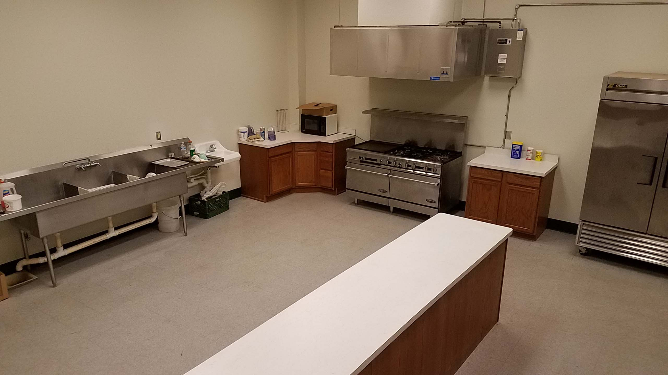
New Kitchen (680 sq. ft.)

Slide 8
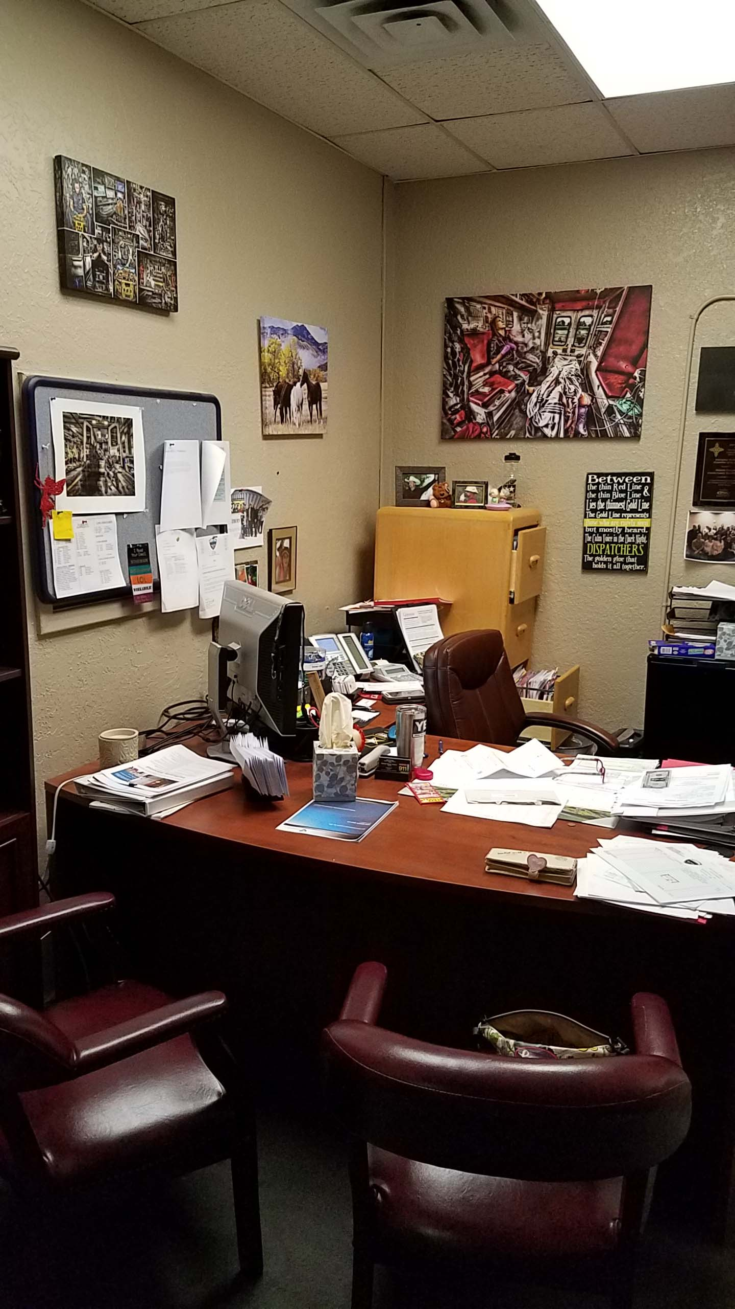
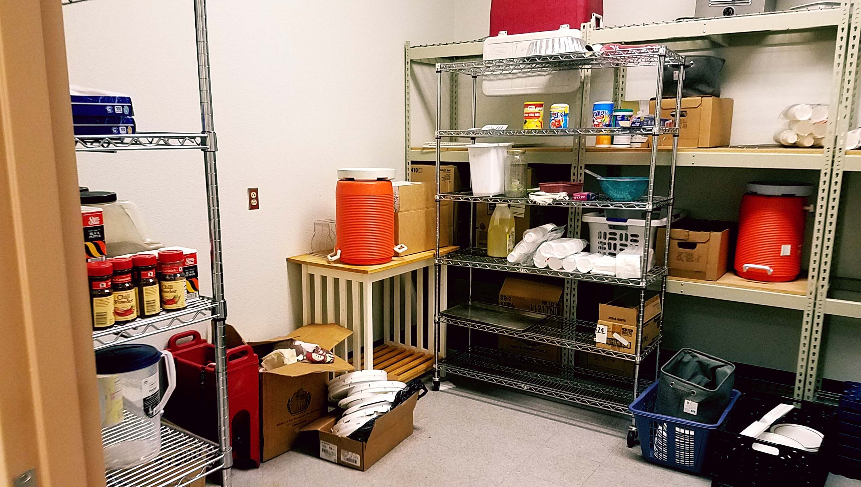
New Directors Office (190 sq. ft.)
Current Directors Office (115 sq. ft.)

Slide 9
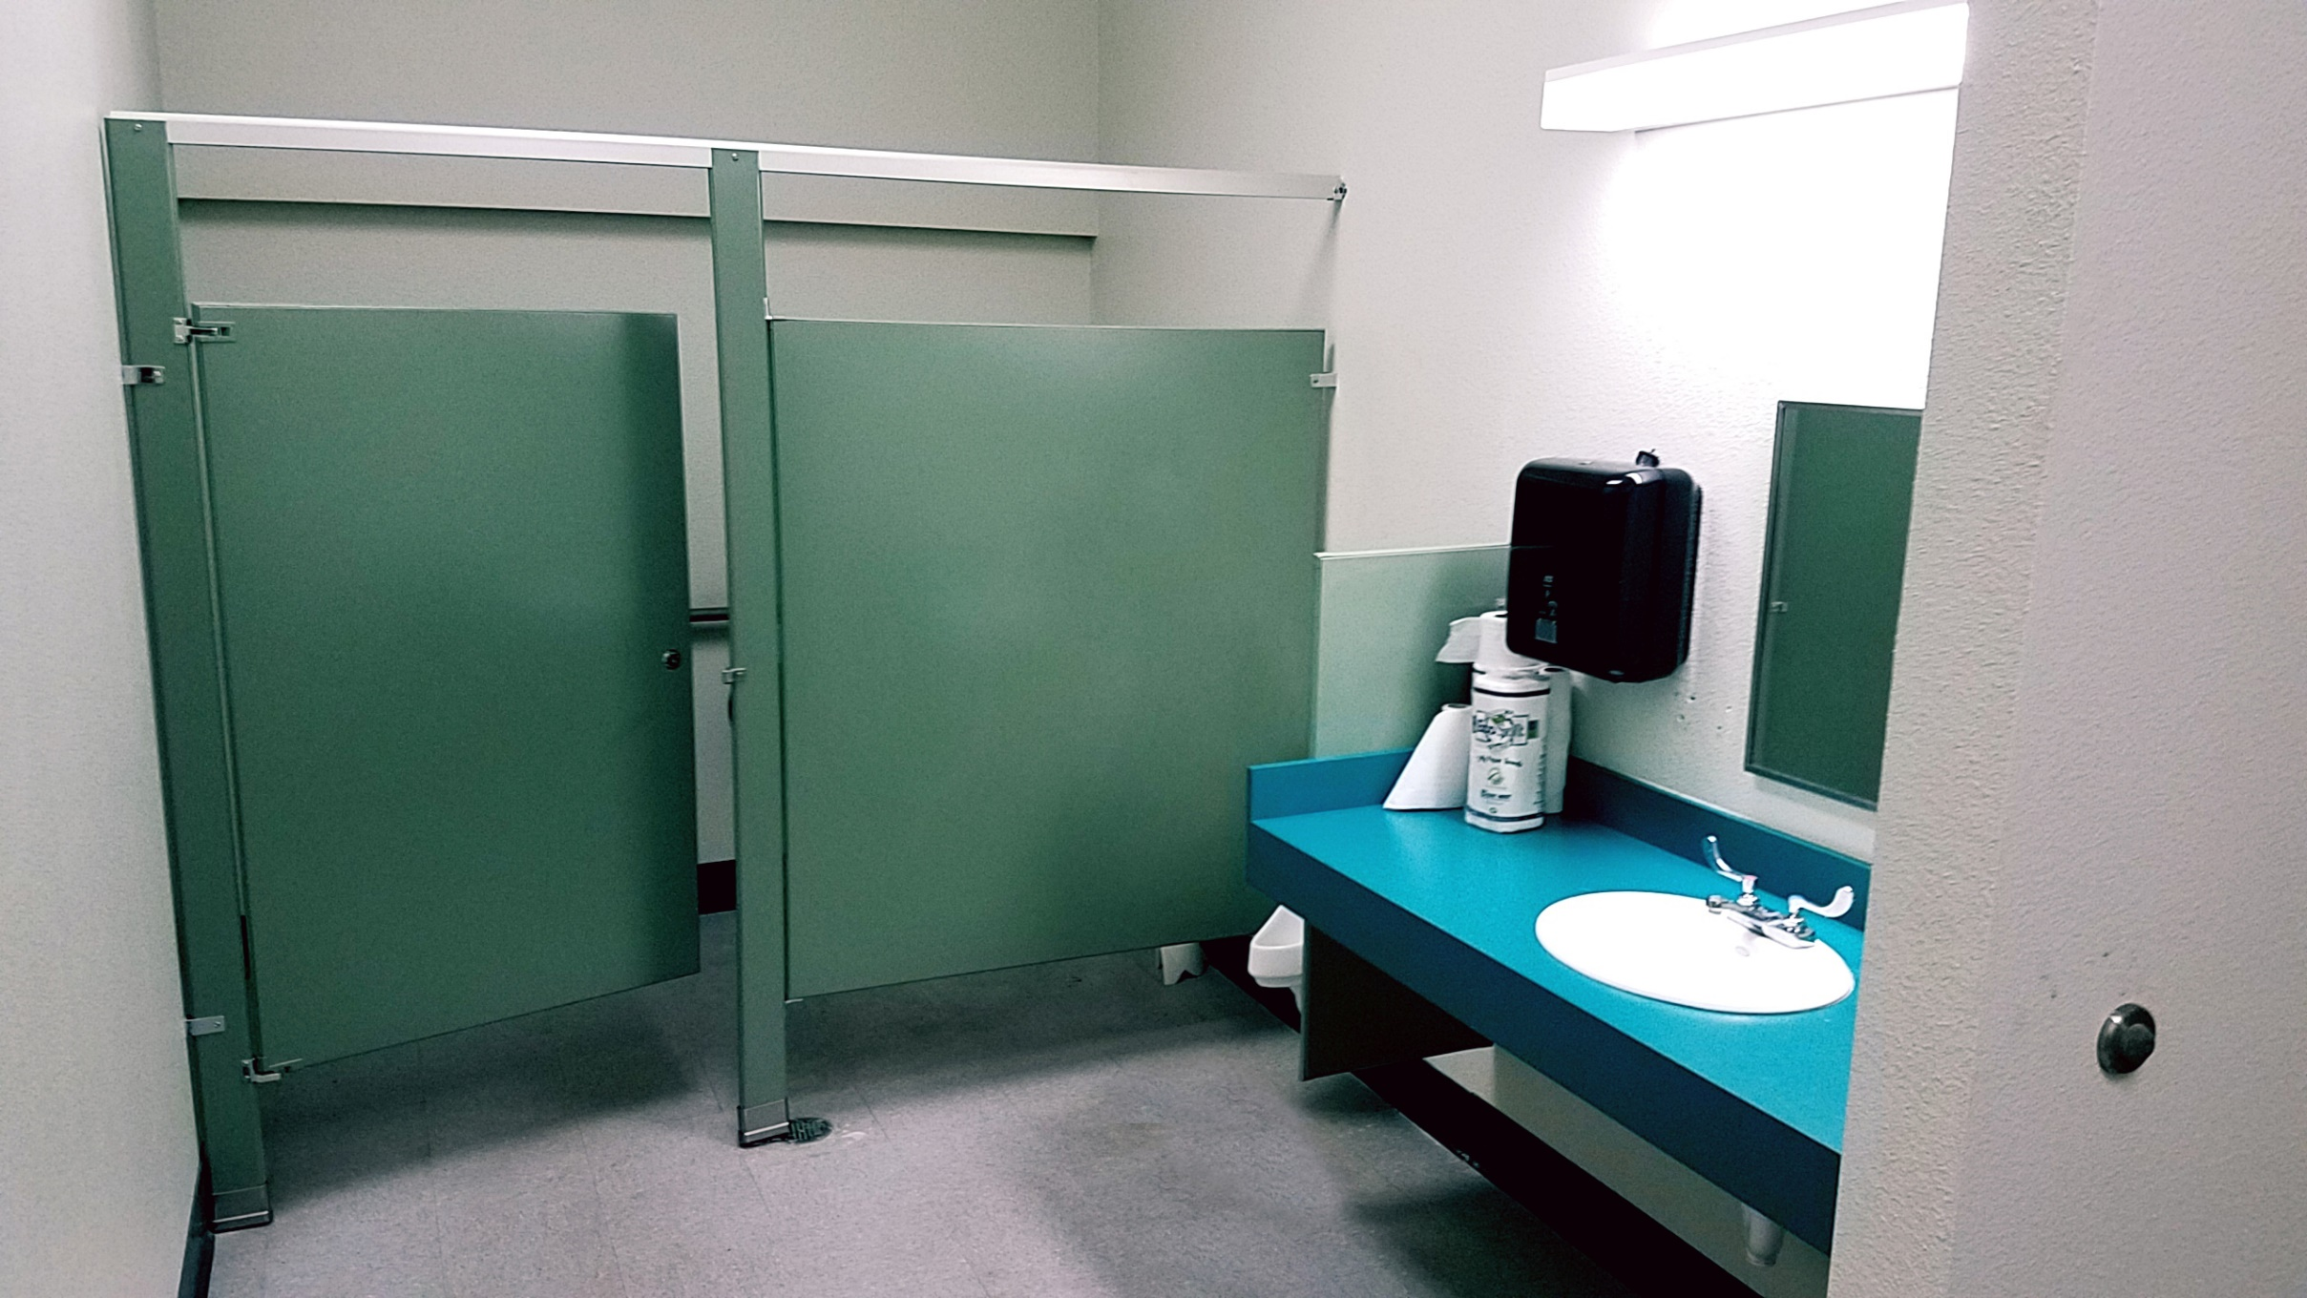
NEW: Men’s Restroom with Shower (190 Sq. Ft.)

Slide 10
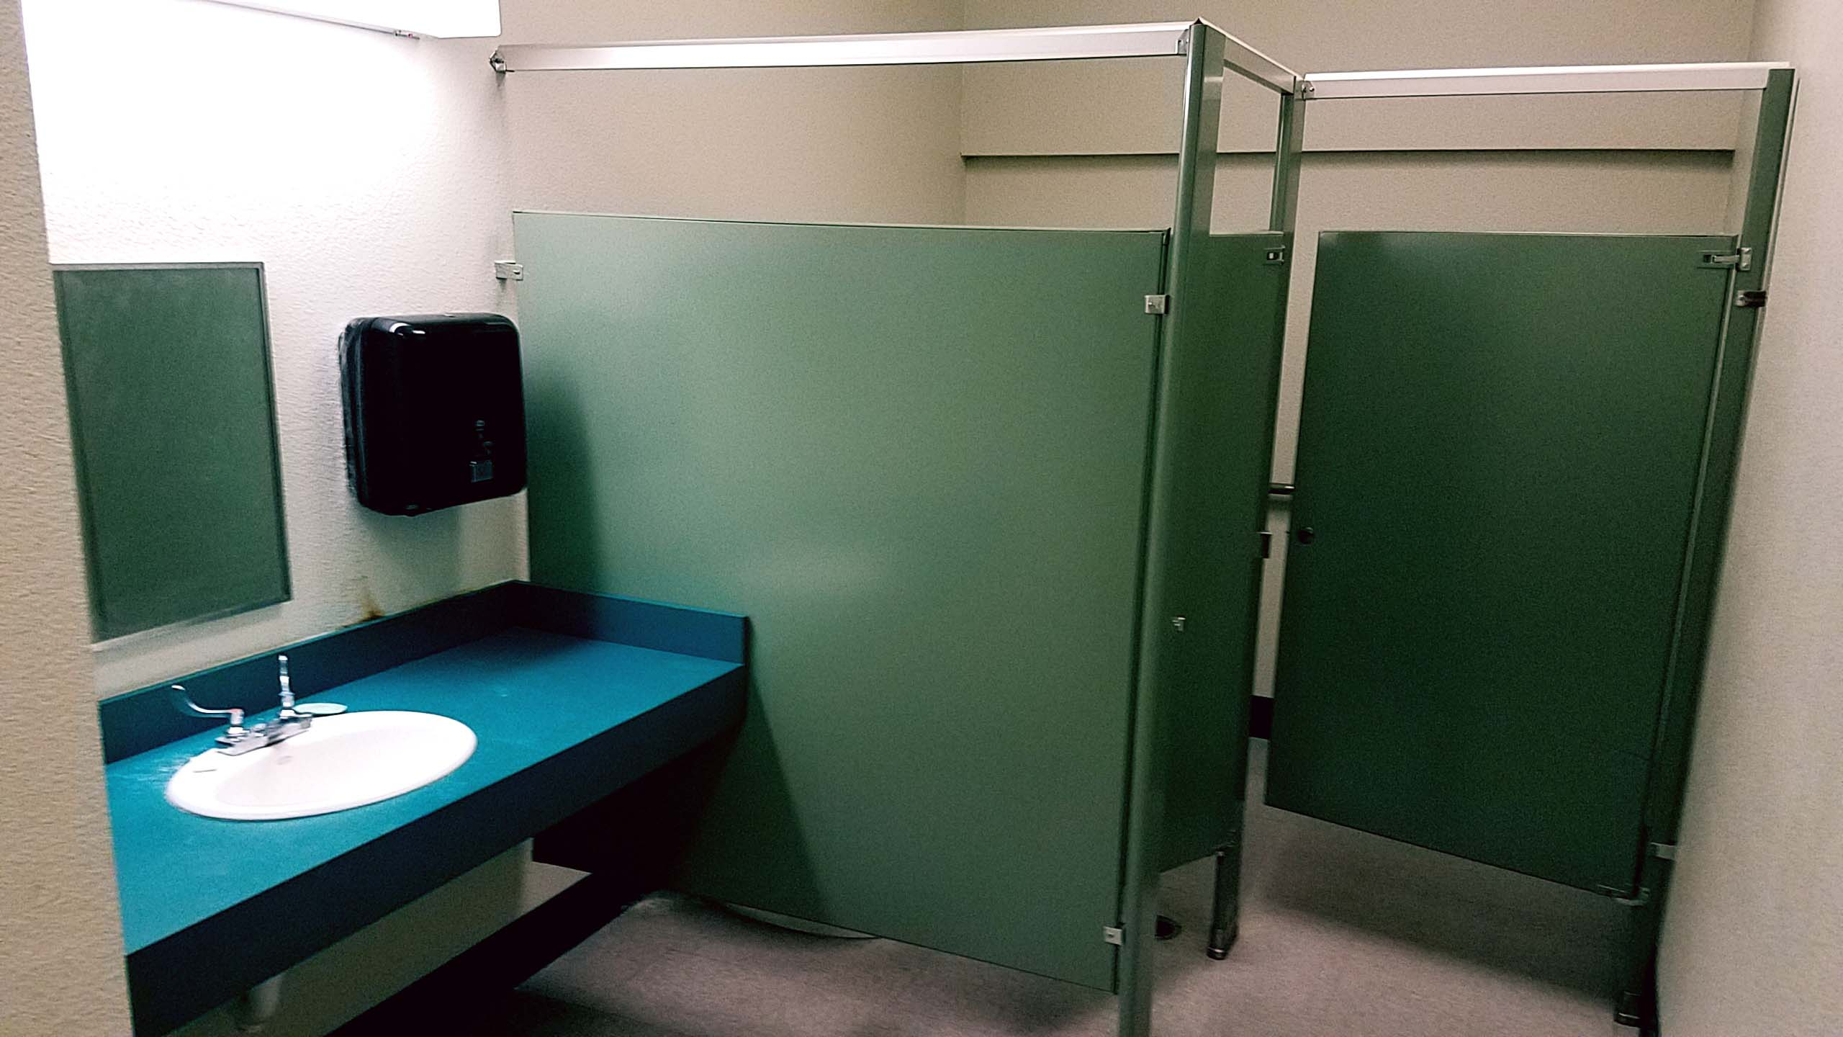
NEW: Women’s Restroom with Shower (190 Sq. Ft.)

Slide 11
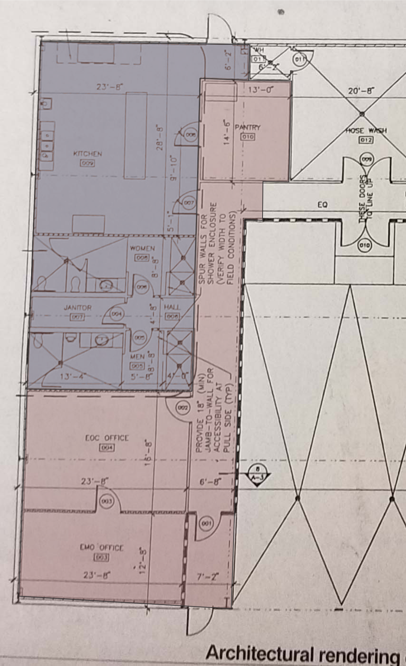
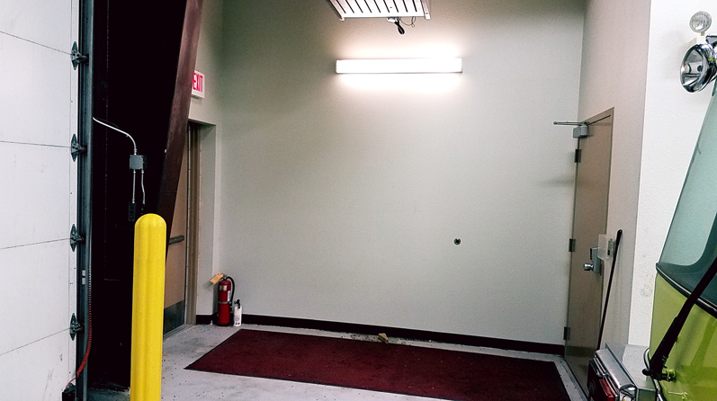
ADD: Hallway & Security
Door into Truck Bay.

Slide 12
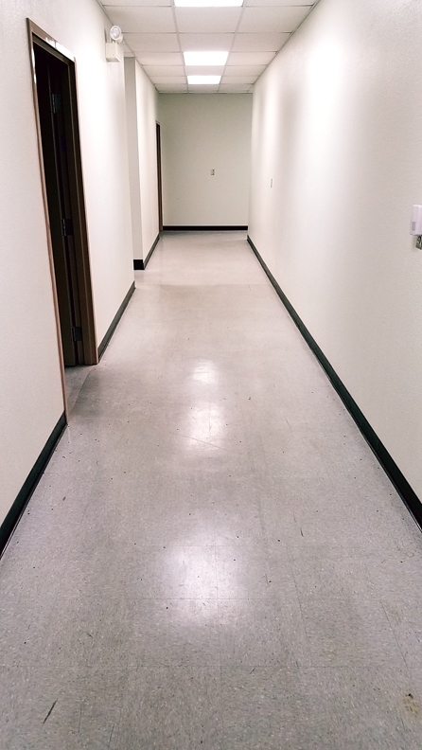
ADD: Door
end of
Hallway.

Slide 13
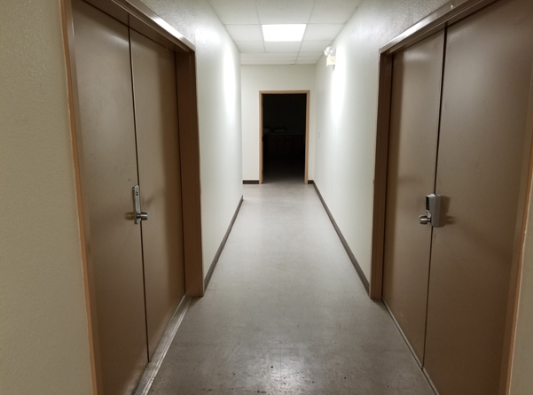
ADD: Door in Hallway.

Slide 14
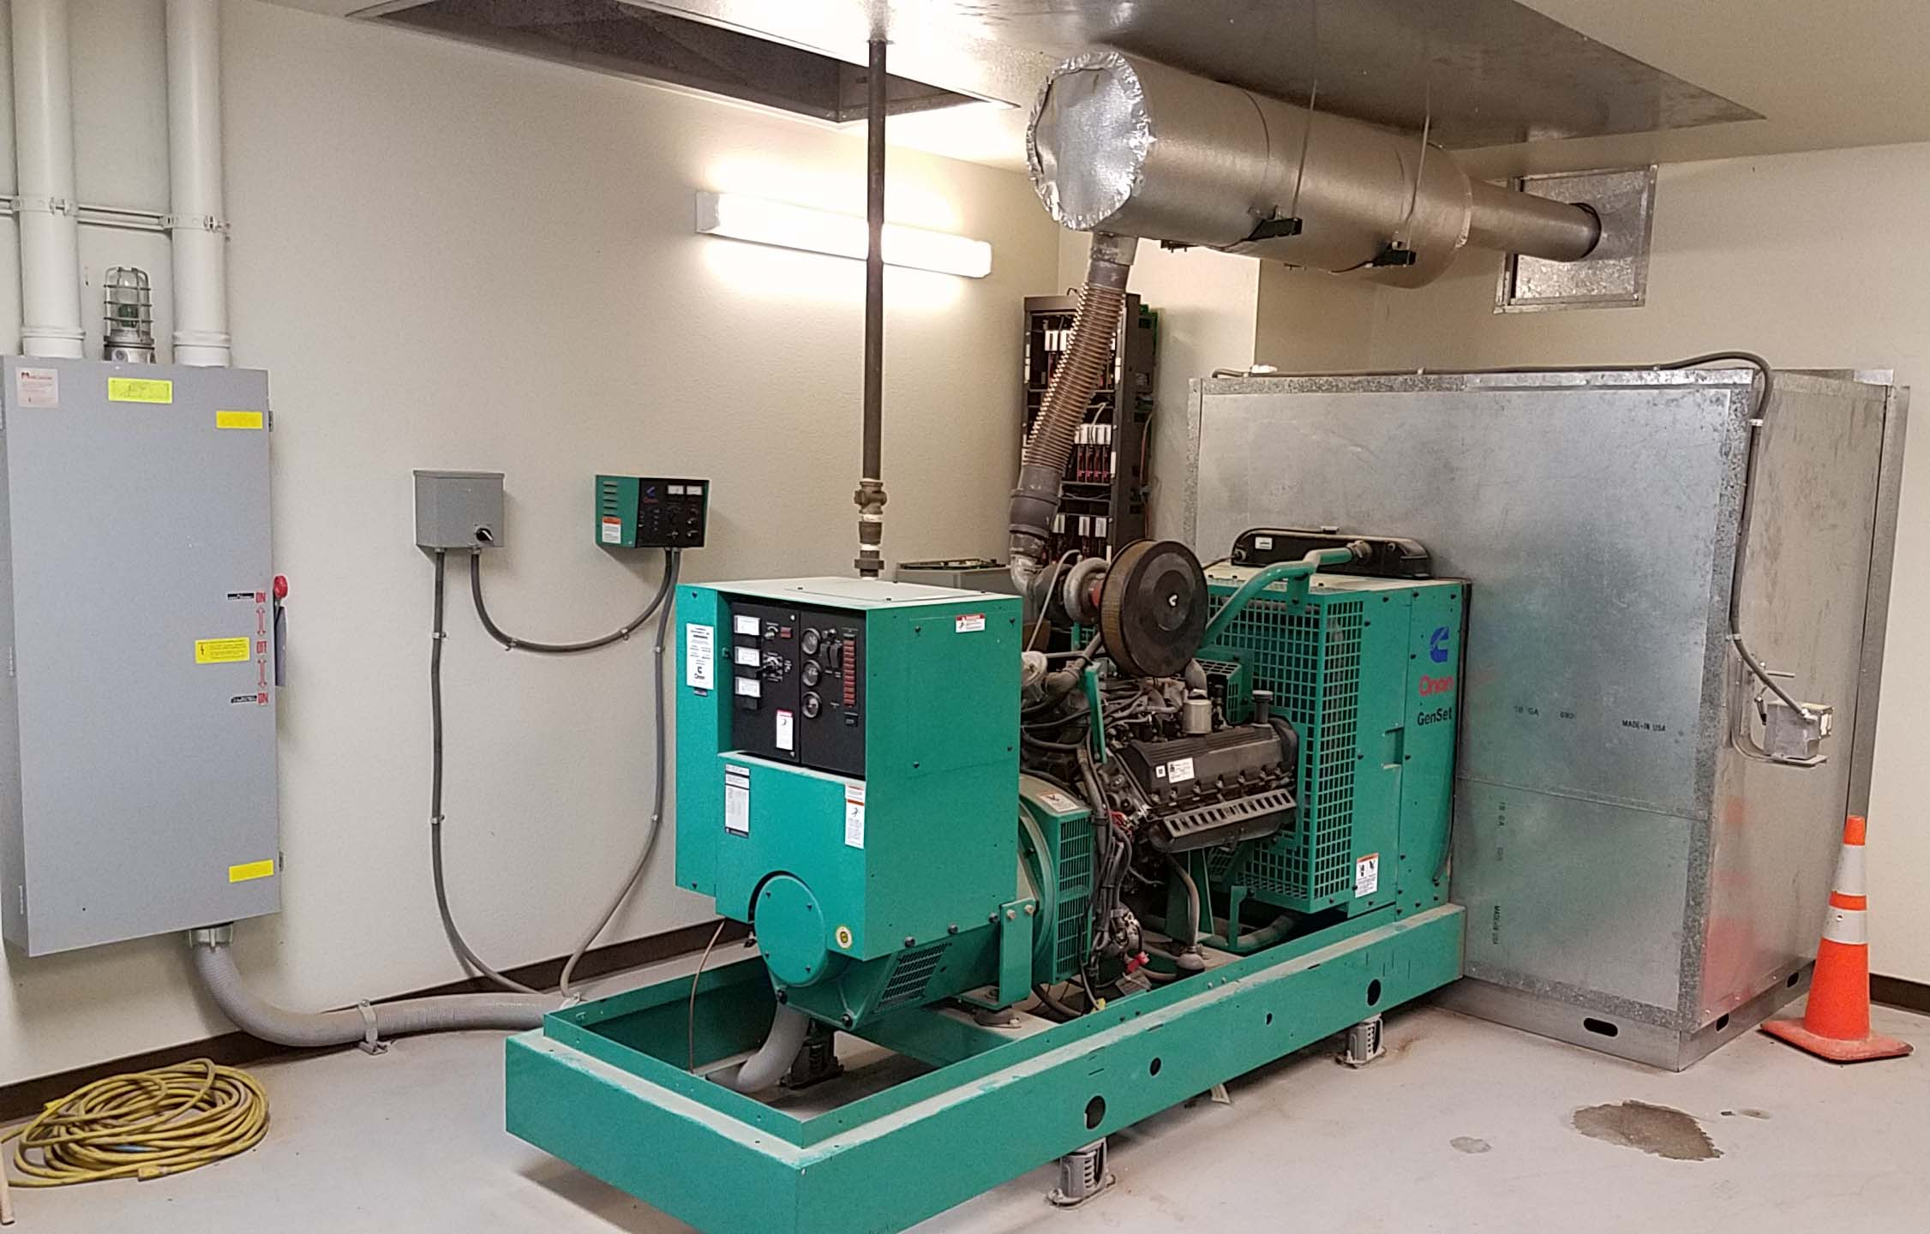
NEW: Generator at Fire Station.

Slide 15
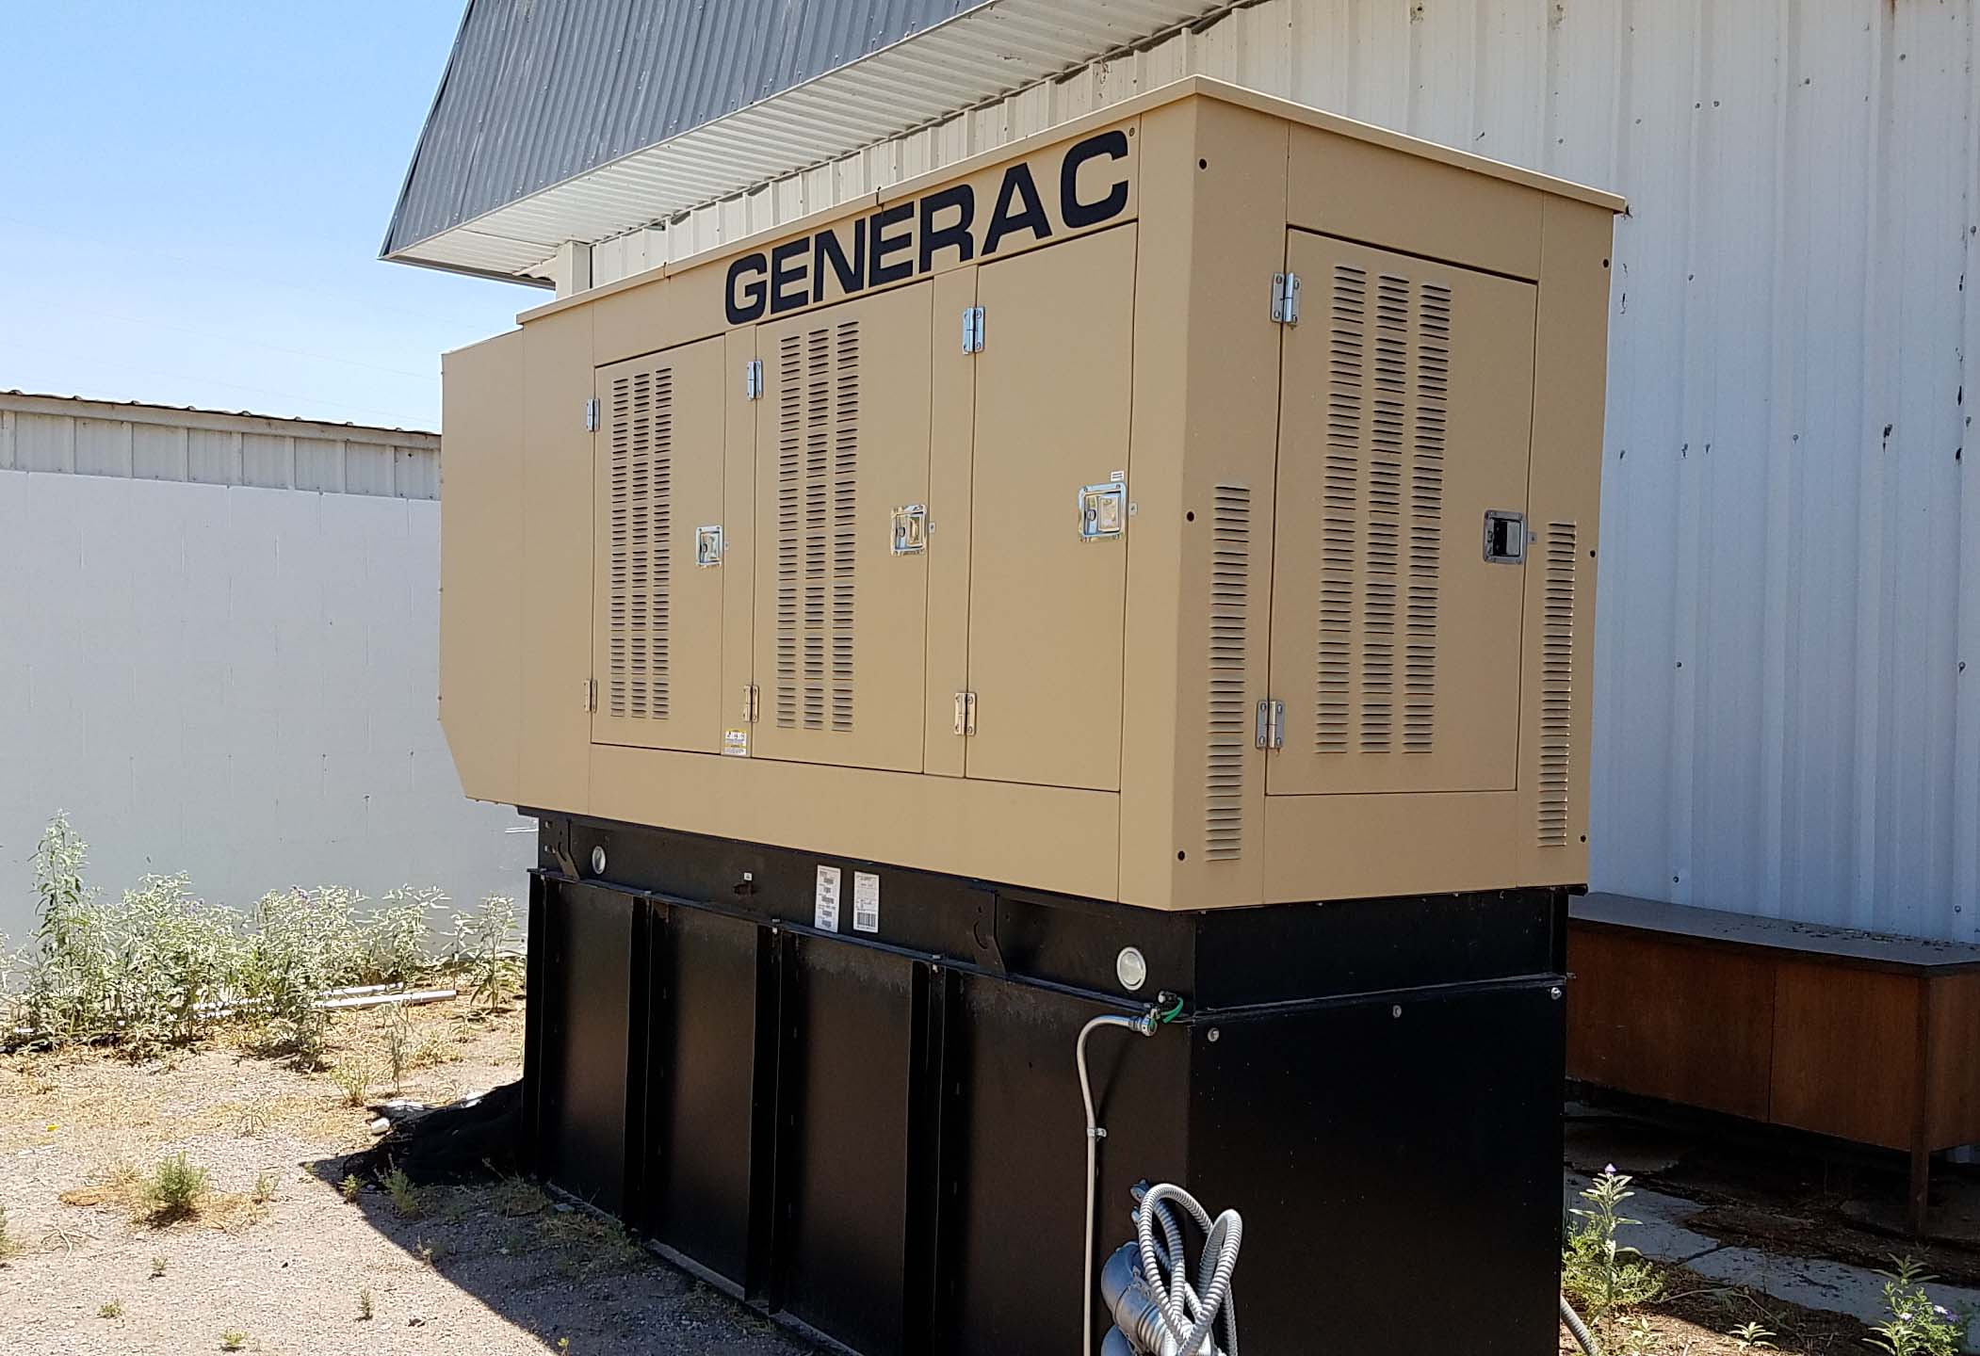
NEW: Generator from MVRDA.

Slide 16
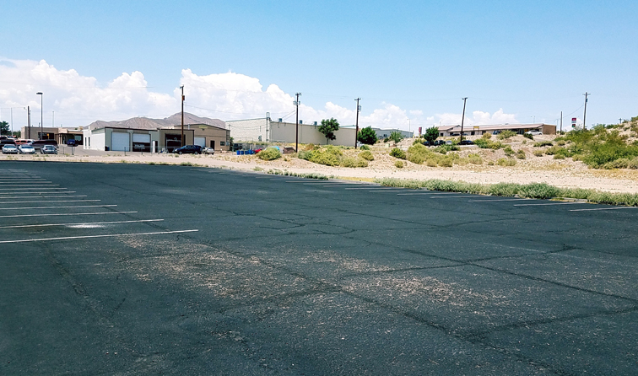
NEW: Parking Area Fire Station.

Slide 17
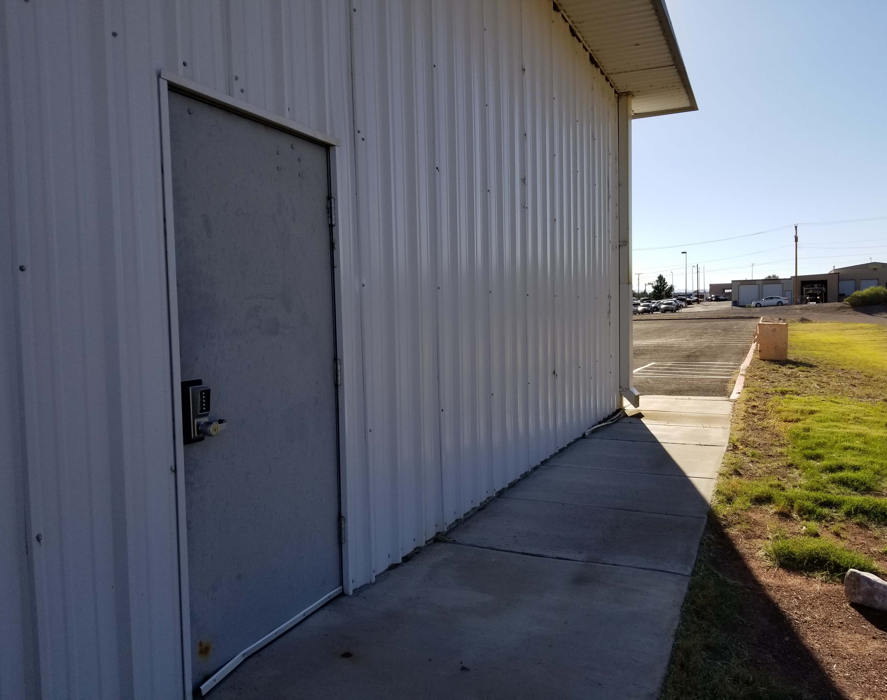
NEW: Back Entrance to Kitchen Area.

Slide 18
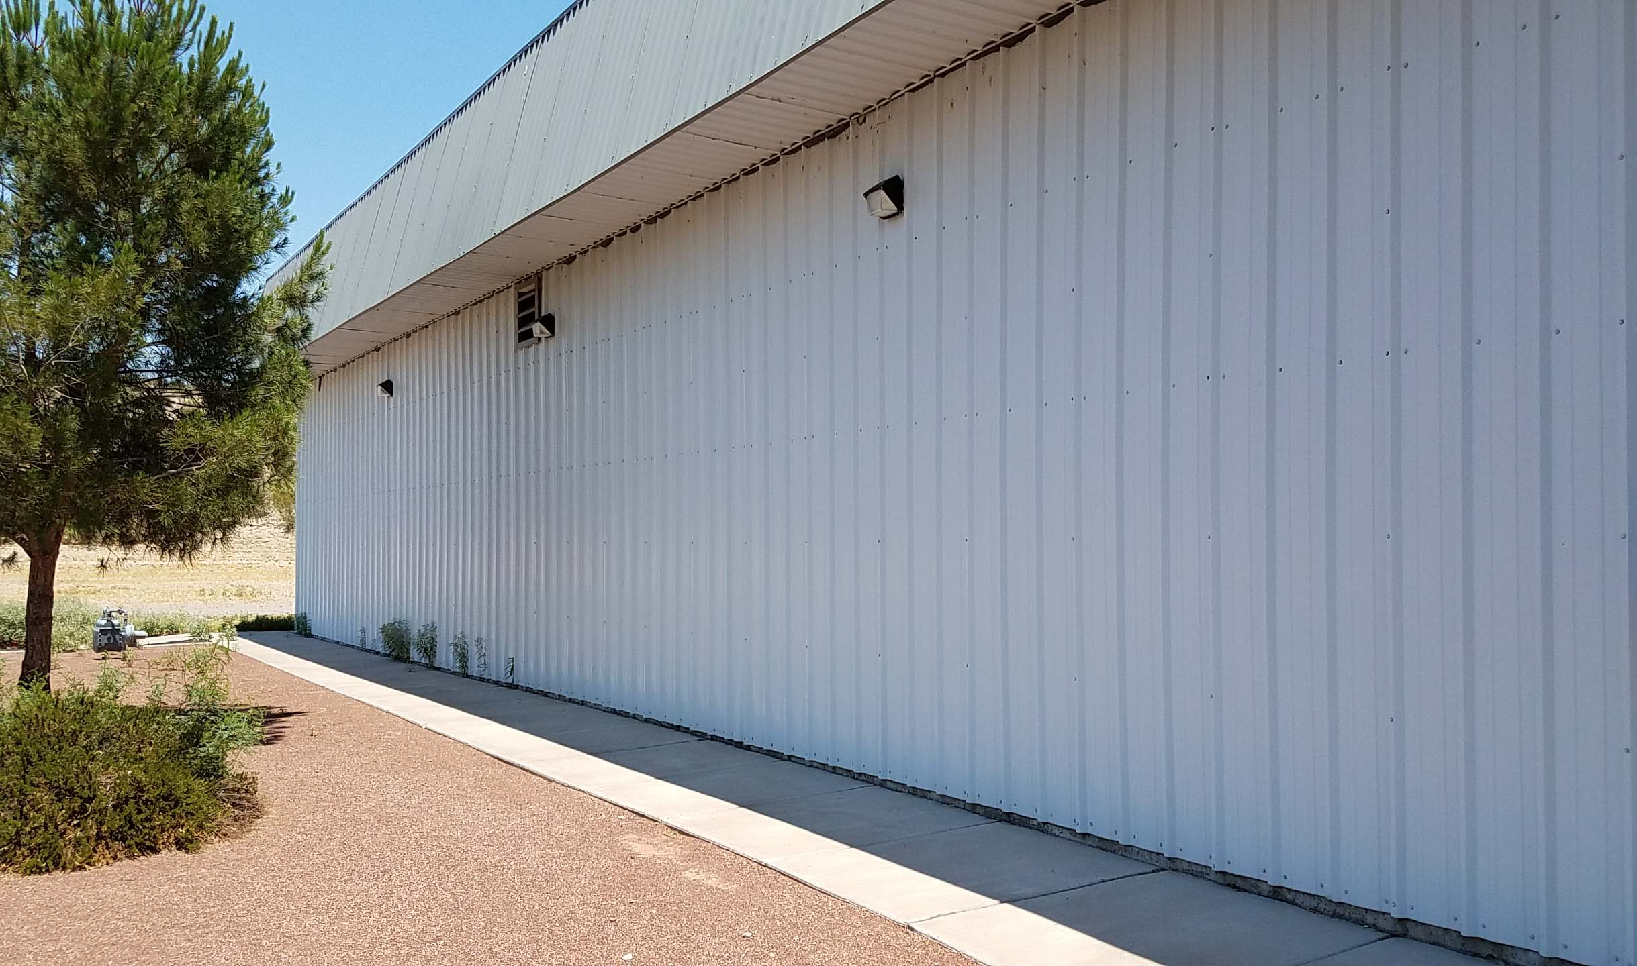
NEW: 10’ Expansion for Storage & Office Space .

Slide 19
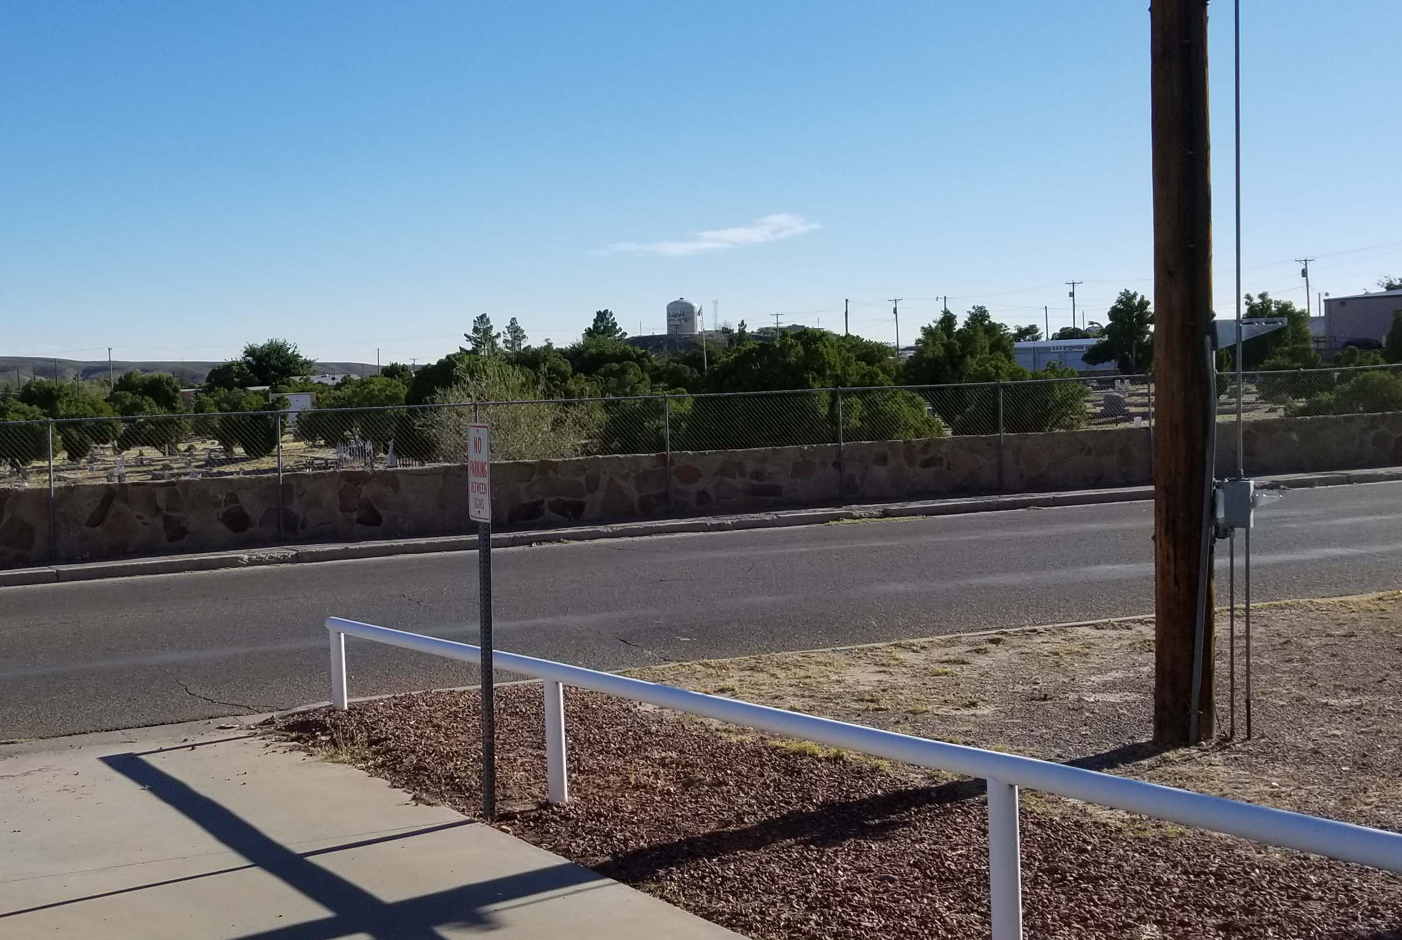
NEW: Direct Line of Site to Tank Hill.

Slide 20
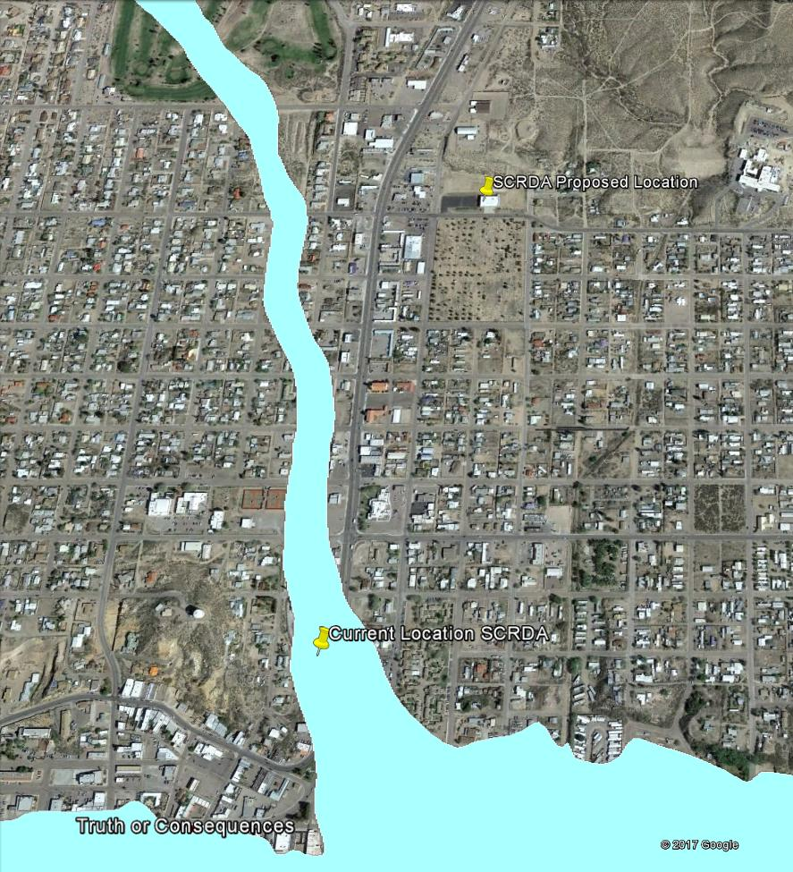
NEW: Out of the Flood Plain.

